Slide 1
Family Behavior Therapy: An
Evidence-Based Approach for Adult
Substance Abuse and Associated Problems
Notes:
1

Slide 2
Workshop Agenda
Theory
Evidence
Overview
Therapeutic Style
Intervention Components
Notes:
2

Slide 3
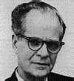
Theoretical Basis
Conceptualizes drug use as a primary reinforcer, enhanced by:
-Modeling
-Encouragement & guidance to use
-Physiological & situational prompts to use
-Insufficient reinforcement for non-drug activities
-Remoteness/uncertainty of neg. consequences of drug use
Derived from Community Reinforcement Approach (CRA)
Notes:
3

Slide 4
Evidence for CRA
Examples of Controlled CRA Alcohol Studies
Azrin, 1976; Azrin, Sisson, Meyers, & Godley, 1982; Miller & Meyers, 2001; Smith, Meyers, & Delaney, 1998; Miller, Meyers, & Tonigan, 1999; Smith, Meyers, & Delaney, 1998
Examples of Controlled CRA Drug Studies
Abbott, Wellner et al., 1998; Bickel, Amass et al., 1997; Dennis, Godley et al. 2001; Higgins, Budney, & Bickel, 1994; Higgens, Budney et al., 1995; Higgins, Budney et al., 1997; Higgins, Wong et al., 2000; Higgins, Sigmon et al., 2003
Notes:
4

Slide 5
Evidence for FBT
Controlled Drug and Alcohol Studies
Azrin, Acierno et al., 1996; Azrin, Donohue et al., 2001; Azrin, Donohue et al., 1994; Azrin, McMahon et al., 1994; Donohue, Azrin et al., 1998
Uncontrolled Drug and Alcohol Studies
Donohue, Romero et al., 2010; Donohue & Azrin, 2002; LaPota, Donohue, Warren, & Allen, 2011; Romero, Donohue, Allen, 2010; Romero, Donohue et al., 2010
Notes:
5

Slide 6
Mechanisms of Change in FBT
Intervention attempts to prevent antecedent conditions that facilitate drug use & other problem behaviors by:
Enhancing social relationships and skills needed to establish abstinence and pro-social behavior.
Teaching strategies to prevent urges and impulsive behaviors that make drug use and other problem behaviors easier.
Allowing or facilitating neg. consequences for drug use
and other problem behaviors.
Notes:
6

Slide 7
FBT Intervention Components in Adults
Structured Agendas
Program Orientation
Goals and Rewards
Intervention Planning
Relationship Enhancement
Communication Skills Training
Environmental Control
Self Control
Job Skills Training
Financial Management
Planning for Success

Slide 8
Format of Intervention Components
Each intervention component includes:
Manual
Detailed explanation of how to implement each intervention
Initial Session Protocol
Step by step checklist used 1st time an intervention is implemented
Future Session Protocol
Step by step checklist used for interventions in subsequent sessions
Worksheets
Assist clients in understanding interventions
Practice Assignments
Homework assignments for client & family to practice skills outside sessions
Notes:
8

Slide 9
Appropriate Targets
Drug and alcohol abuse:
Mood disorders
Family dysfunction
Conduct
Unemployment
Child Neglect
Notes:
9

Slide 10
Assessment
Administer assessment measures before, during & after intervention
Person administering, interpreting, and recording assessment needs to be legally, competently, and ethically qualified
Measures must be consistent with presenting problems and agency requirements (Allen, Donohue, Sutton, Haderlie, and LaPota, 2009).
Broad-screen urinalysis testing/breathalyzers
Self-reports of substance use (e.g., Timeline Follow-back)
Measures of psychiatric symptoms & mental health diagnoses
Family Environment Scale/satisfaction measures
Risk Assessment Battery
Notes:
10

Slide 11
Number of Sessions
Up to 16 tx. sessions
Each session about 60 to 90 mins.
Tx. Usually lasts 4 to 6 months, depending on context.
Sessions fade in frequency as goals are accomplished.
Notes:
11

Slide 12
Significant Other Support
Identified client
Primary sig. others = usually partner/family/close friend(s)
2ndry sig. others = other family/friends
Sig. others need to be:
sober or desire sobriety and be relatively adjusted
have an interest in client’s well-being
Sig. others help client:
attend therapy
complete homework assignments
provide encouragement & rewards
model skills
provide insights
Role of small children is limited (e.g., participate in review of scheduled family activities, appreciation exchanges; non-drug problem-behav. conversation)
Notes:
12

Slide 13
Order and Extent to Which Interventions Implemented
Post-Assessment
1st: Orientation session (once)
2nd: Establish goals and rewards for drug-free lifestyle
(weekly - biweekly)
3rd: Intervention Planning (once)
*Remaining interventions occur based on family interest
(usually successive and cumulative).
Notes:
13

Slide 14
Prompting Checklists Guide
Providers During Sessions
Prompting checklists prompt specific steps required to implement each of the intervention components.
All intervention components:
Initial Session Prompting Checklist
Most intervention components:
Future Session Prompting Checklist
Notes:
14

Slide 15
Prompting Checklists Guide
Providers During Sessions
General content of initial intervention session prompting checklists:
materials required
rationale for intervention
steps necessary to do intervention
ratings of helpfulness & client compliance
General format of future intervention session prompting checklists:
materials required
steps necessary in reviewing assignment
steps necessary in giving new assignment
ratings of helpfulness & client compliance
-Glance at checklist, look up, and proceed to implement.
-Free to do whatever clinically indicated between prompts.
Notes:
15

Slide 16
Intervention Integrity
What is intervention integrity?
How do you feel about intervention integrity?
Programs that utilize standardized manuals and evaluate intervention integrity are consistently rated better than those programs that do not (Moyer, Finney, & Swearingen, 2002).
Integrity = # of protocol items completed /#possible.
Reliability = # of agreements / # agreements + disagreements X 100.
intervention Integrity Review Form (see p. 17 in book)

Slide 17
Therapeutic Style and Approach
Differential Reinforcement
Descriptive Praise
Eliminate Blame- Blame the Situation or Environment
Learn by Doing (Role-playing)
Involve Significant Others
Target Antecedents to Problem Behavior
Permit Negative Consequences to Occur After Undesired Behavior

Slide 18
Role-Playing
Most FBT intervention components use role-plays to teach skills.
Neg. assertion in avoiding punishment
(responding to upset or criticism in others)
Pos. assertion in soliciting reinforcement
(asking a friend for a ride)
Refusing offers to use illicit drugs or alcohol.
Notes:
18

Slide 19
Therapy Assignments
Strategies to increase homework completion:
Role-play w/ clients until they can do skills in difficult scenarios (start w/ easy scenarios & prepare them for success at home).
Role-play assignment recording process w/ family & state it will be reviewed.
Establish where recording form will be kept & when it will be reviewed.
When reviewing homework, instruct family to provide form, don’t ask for it.
Blame homework failure on external event.
Instruct family to complete missed assignment in retrospect based on memory or what they would have liked to have done.
Notes:
19

Slide 20
What if a Significant Other is Unavailable for Session?
Emphasize intervention components that do not require participation of significant others.
Indicate not applicable (NA) for prescribed protocol steps in prompting checklists not conducted due to absence of sig. other.
These instructional steps are not considered for intervention integrity.
Notes:
20

Slide 21
How To Manage Upset in Sig. Other(s) During intervention Sessions?
Establish communication guidelines early in therapy
Hear, Empathize, Alternatives, Review, Decide (HEARD)
Instruct upset sig. other(s) to explain how they may have contributed to the problem.
Teach upset sig other(s) to blame problem behavior on some aspect in the environment that is beyond control.
Instruct upset sig. other(s) to use Positive Request Handout to express what they desire.
Notes:
21

Slide 22
Phone Contact to Enhance Attendance and Participation
Initial engagement call (client & sig. other separately)
Solicit reasons for referral and empathize.
Empathize w/ concerns.
Query goals & express importance of such desires.
Briefly express desires will be targeted in FBT.
Have repeat scheduled session time & how to get to clinic.
Tell to come 5-mins. early to beat traffic.
Review obstacles to session attendance and review solutions.
Between session calls (2/3 days prior to sessions; client/sig. other separately)
things done well in past.
therapy assignments.
what looking forward to in next session.
Notes:
22

Slide 23
Orientation Session
Includes client & significant others at start of therapy to review:
intervention structure and approach
feelings about referral
feedback relevant to assessment findings
Satisfaction Scales (Life, sig. other w/ client, client w/ sig. other)
0 = completely unhappy, 100 = completely happy
Assess how 100% satisfaction can occur in areas that are low.
Notes:
23

Slide 24
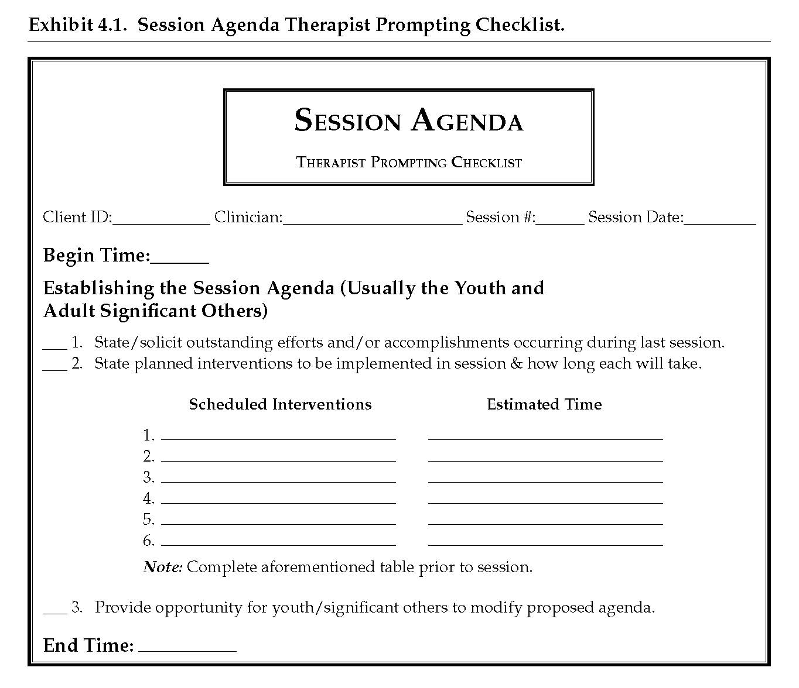
Preparing Initial Drafts for
Session Agendas
See Page 69
Agendas are determined by intervention plan & progress in therapy components.
Review interventions planned.
Review time needed for each intervention.
Solicit potential modifications.
Notes:
24

Slide 25
Session Agenda
Video Link: Session Agenda (1:53)
Notes:
25

Slide 26
Establishing Goals and Rewards for Maintaining a Drug-Free Lifestyle
There are people, places, emotions, thoughts, and situations that trigger drug use.
Client will set goals with sig other assistance to stay clean.
Drug-Incompatible Goals Worksheet establishes lifestyle choices and behavioral stimulus which lead to drug use.
Primary Goals worksheet focused on life goals the client feels will maintain drug-free lifestyle.
Notes:
26

Slide 27
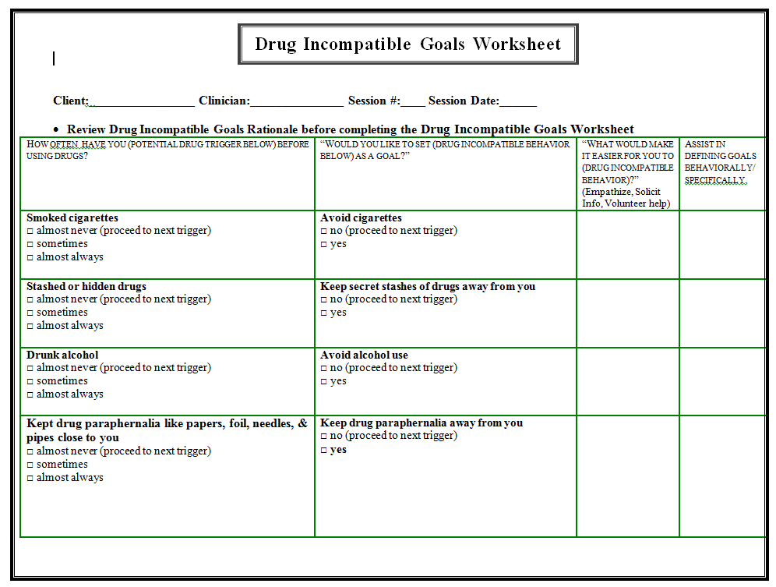
Drug Incompatible Goals Worksheet
See Pages 91-94
Provide rationale
Choose goals from list
Get rewards from sig. other for doing goals
Provide sig. other rewards.
Review DIG worksheet
Assist client with creating specific drug incompatible goals w/ sig. other.
Notes:
27

Slide 28
Primary Goals Worksheet
Complete Primary Goals Worksheet
Show Primary Goals Worksheet w/ obligatory & personal goals
Determine what goals will be a focus for upcoming week
Solicit and record rewards from client and sig other
Obtain signature/commitment from client and sig other
See Pages 95-96
Notes:
28

Slide 29
Intervention Planning Rationale
Intervention Plans determined by client & sig. others.
Client & sig. other(s) determine extent to which interventions will be emphasized in therapy.
Notes:
29

Slide 30
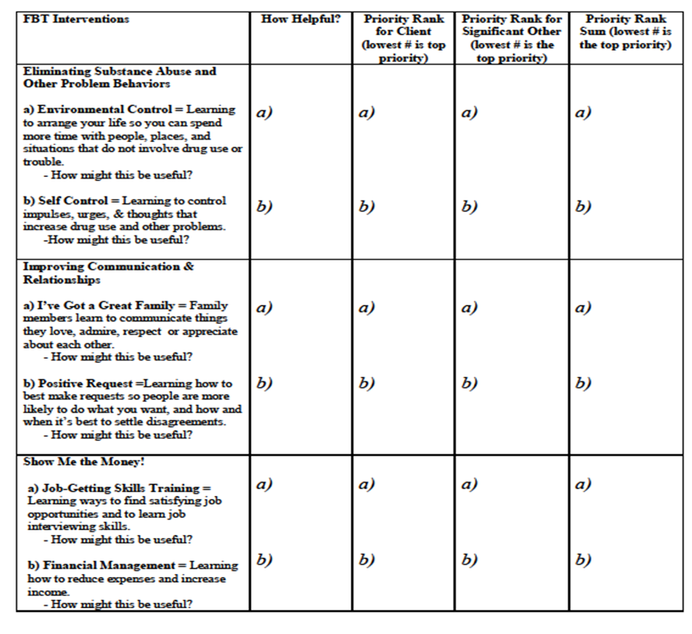
Intervention Priority Worksheet
See Pages 105-106
Read summaries
Solicit how helpful
Obtain rankings from client & sig. other
Sum priorities
Implement interventions in order corresponding to rankings (lowest to highest)
Notes:
30

Slide 31
Relationship Enhancement
Healthy relationships are marked by an equitable exchange of reinforcement.
Family members express appreciation for one another in this intervention.
Implemented early in FBT & when tension is present in family.
Notes:
31

Slide 32
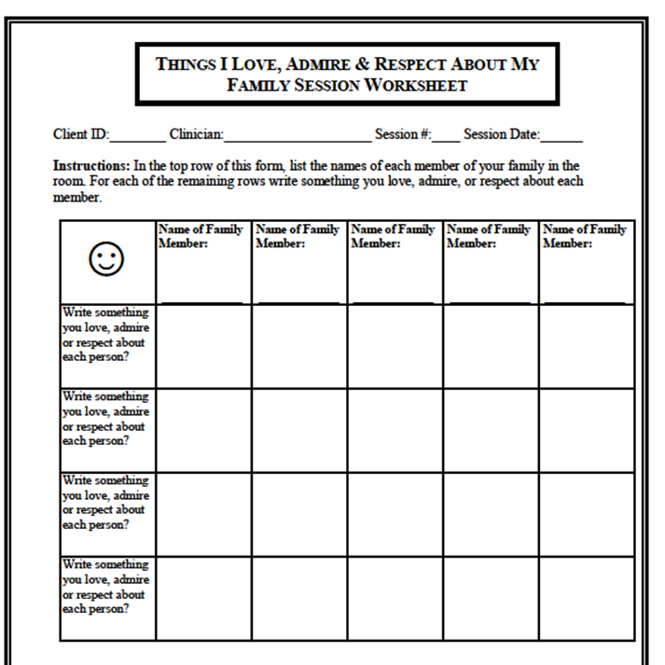
Relationship Enhancement
See Page 114
Provide rationale
Instruct members to record things that are appreciated about one another.
Exchange appreciations.
Encourage recipients to indicate appreciated things will continue.
Notes:
32

Slide 33
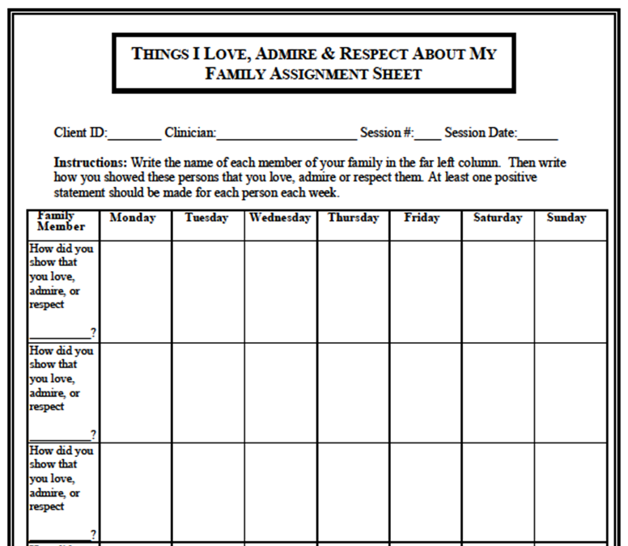
Relationship Enhancement
See Page 114
Provide form to assign homework.
Assist family in recording family members.
Assign 1 appreciation for each family member daily.
Get commitment from each member to do assignment.
Remind family each statement should be reciprocated!
Notes:
33

Slide 34
Positive Request
Poorly stated requests result in less reinforcement, leading to upset/dissatisfaction.
Negative emotional states lead to undesired behaviors.
Arguments to intensify importance of what is desired.
Drug use to eliminate negative emotional states.
Positive Request is designed to improve positive communication.
Notes:
34

Slide 35
Positive Request Role-Play
See Page 134
Distribute PR Handout.
Indicate all listed steps will be attempted in practice, but all are not necessary in real-life situations.
Solicit example of something desired by 1 member.
Role-play w/ family.
Notes:
35

Slide 36
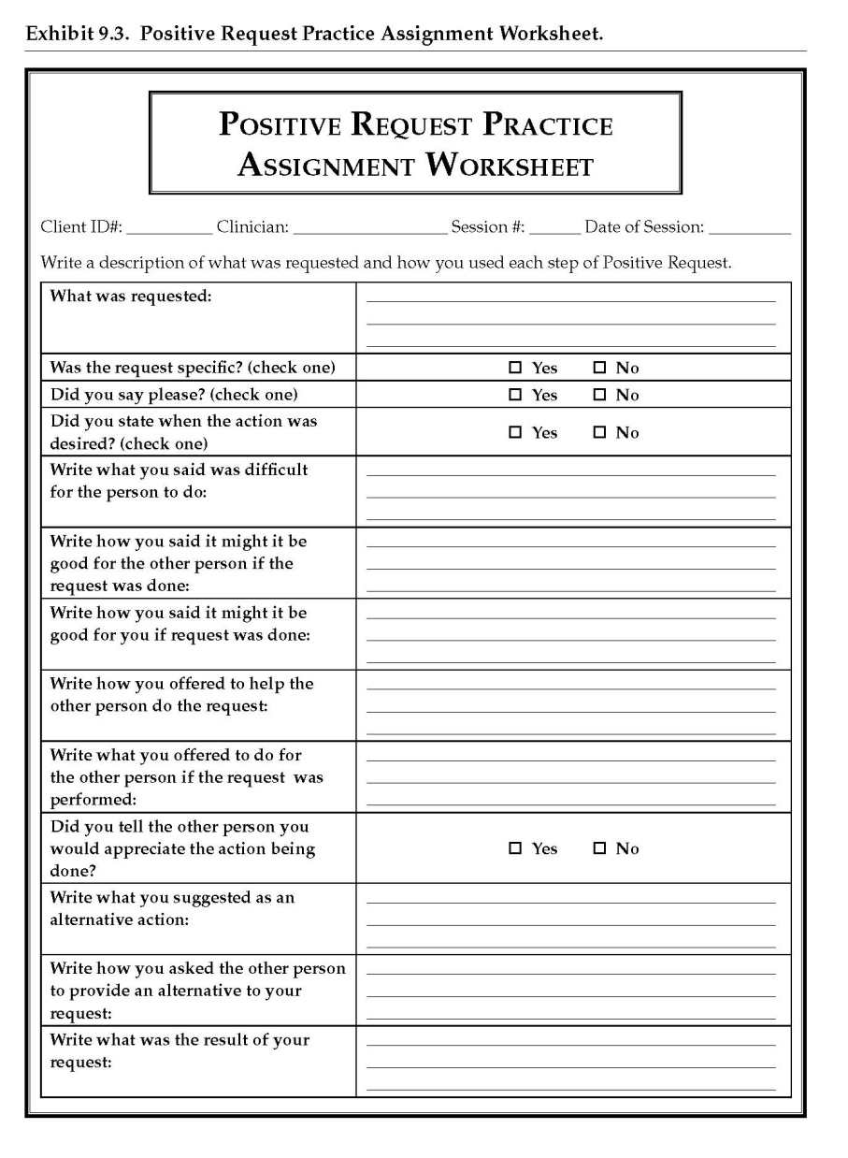
Positive Request Homework
Assign homework for review in future session.
See page 135
Notes:
36

Slide 37
Positive Request Assignment
Video Link: Part 1 (11:42) Impromptu
Part 2 (7:36) Rationale/ TP models PR
Part 3 (5:27) Role-Play PR w/client
Notes:
37

Slide 38
Environmental/Stimulus Control
Triggers in the environment lead to drug use and problem behaviors.
In this intervention, client and sig. others are taught to identify “at-risk” and “safe” triggers for client.
The team then works to restructure the environment to minimize time with “at-risk” items.

Slide 39
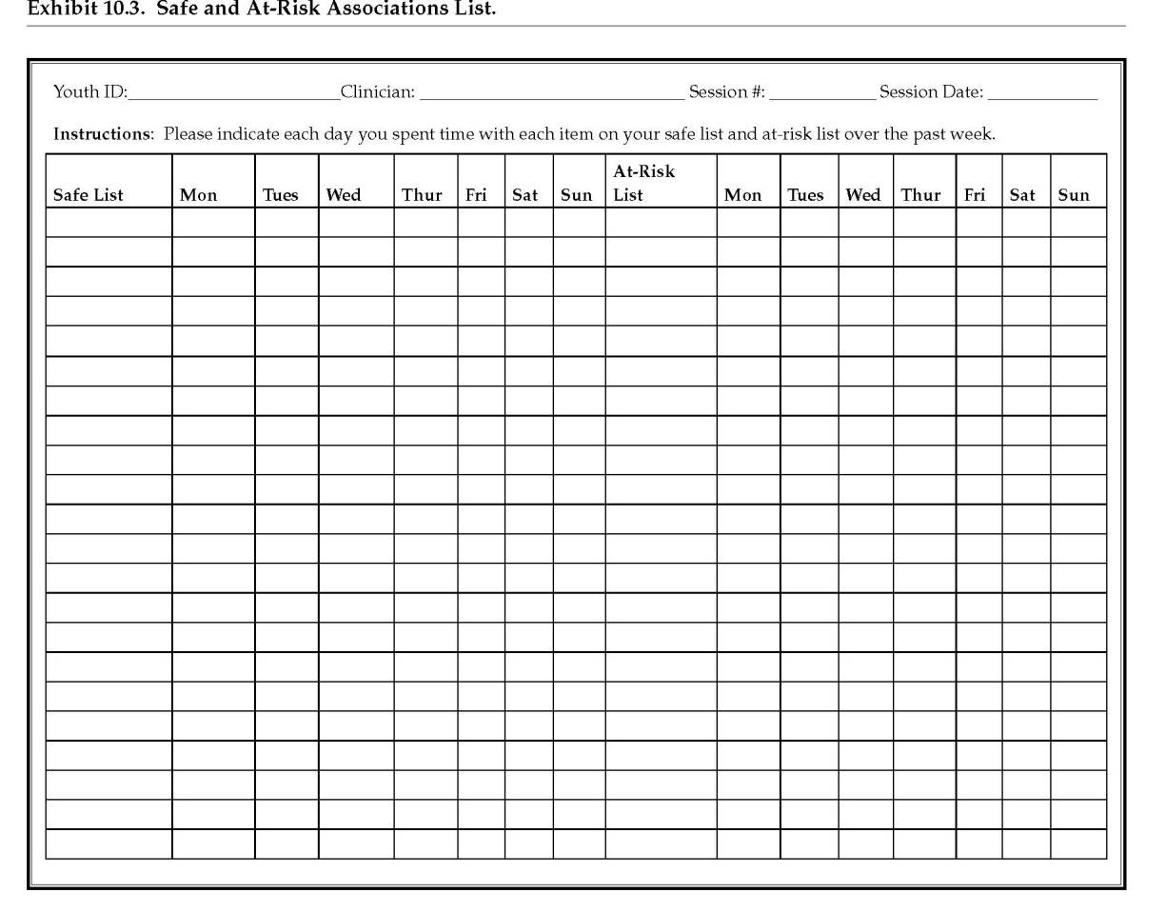
Developing “Safe/At-Risk” lists
See Page 165
Obtain w/ client & sig other individually to generate a comprehensive list of “safe” and “at-risk” items to drug use/problem behavior.
Notes:
39

Slide 40
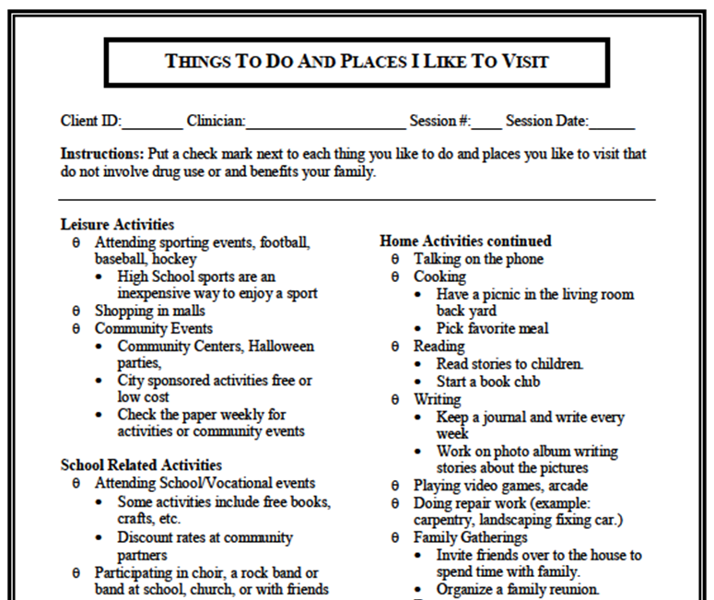
Environmental/Stimulus Control
See Page 166
Use the “Things to Do and Places I Like to Visit Worksheet” to generate additional “Safe” items.
Notes:
40

Slide 41
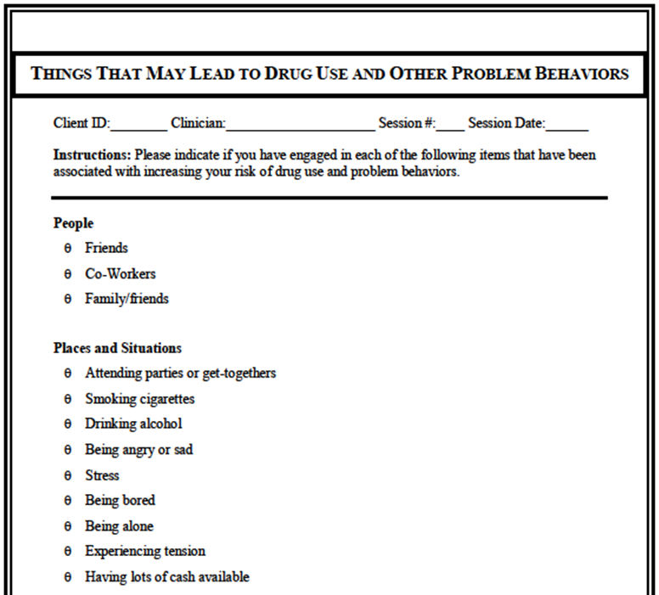
Environmental/Stimulus Control
See Page 167
Use “Things That May Lead to Drug Use and Other Problem Behaviors” Worksheet to generate additional “At-risk” items.
Notes:
41

Slide 42
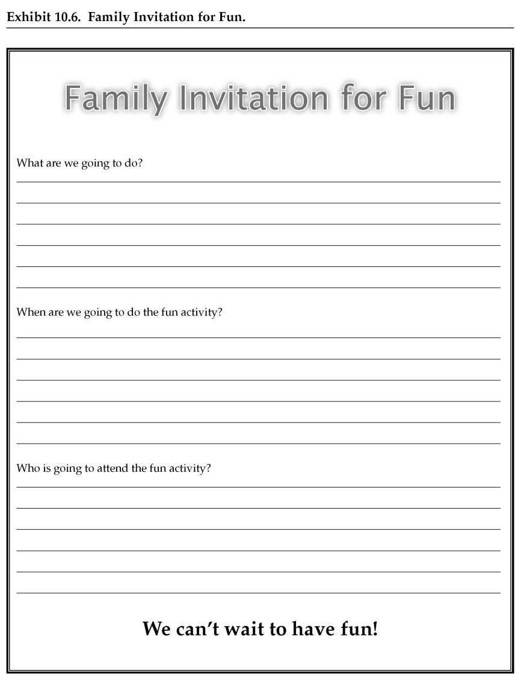
Environmental/Stimulus Control
See Page 168
Solicit family activity from client.
Notes:
42

Slide 43
Environmental/Stimulus Control
Future sessions involve:
Review assigned family activity, & assign another activity.
Meet w/ client & sig. other to review Safe Items.
Meet w/ client & sig. others individually to review At-Risk items.
Solicit things client did (or can do) to stay clean & out of trouble.
Solicit things sig. other did (or can do) to assist client in staying clean & out of trouble.

Slide 44
Environmental/Stimulus Control
Video Link : Part 1 (2:18) Rev. likes/dislikes of Triggers w/client
Part 2 (0:25) Solicit Confidentiality w/client
Part 3 (18:37) Rev. time spent w/ items on “safe”/ “at-risk” lists (future session)
Notes:
44

Slide 45
Self Control
Drug use & troublesome behavior are associated with w/ impulse control problems.
Self Control designed to teach client to identify antecedents to problem behavior, and subsequently engage in non-problem behavior.
Notes:
45

Slide 46
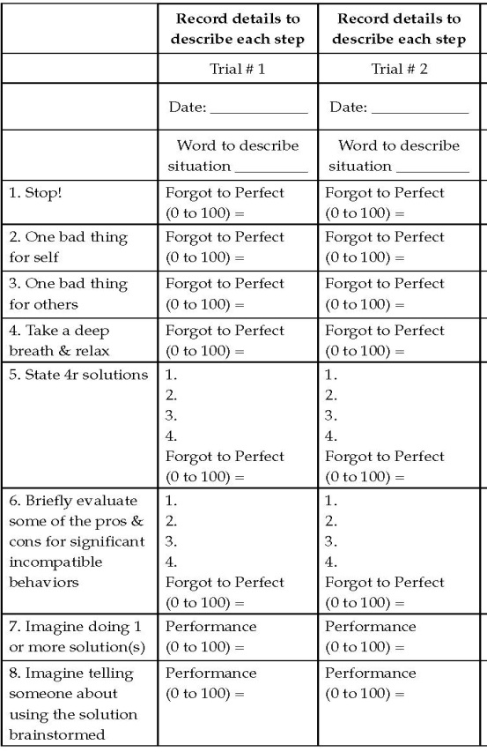
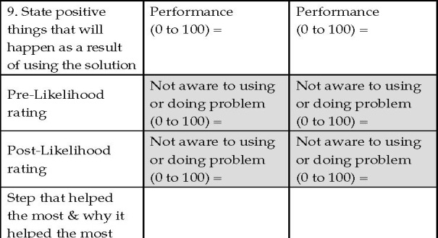
Self Control
Solicit trigger situation
Model steps 1–8
Review pre/post likelihood ratings
Indicate step that helped most
Grade trial
Have client practice SC
Notes:
46

Slide 47
Self Control
Video Link: Part 1 (10:50) Brainstorm triggers with client/TP Models SC/Client rates TP
Part 2 (8:04) Role-Play SC w/client
Part 3 (9:46) client/TP rate client’s role-play of skills
Notes:
47

Slide 48
Job-Getting Skills Training
Employment usually incompatible with drug use/problem behavior.
Job-Getting Skills Training assists in getting job interviews, and doing well in these interviews.
Notes:
48

Slide 49
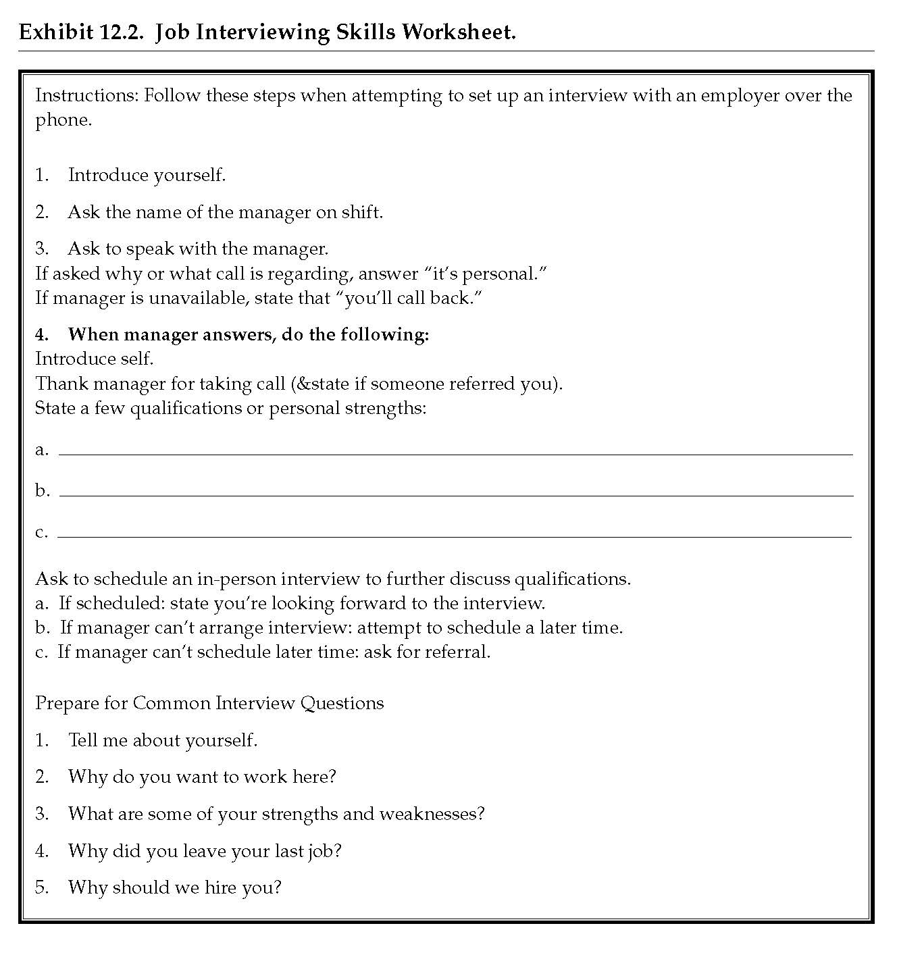
Gaining Employment
Review how a job would assist client.
Determine 3 strengths of client relevant to gaining employment.
Determine potential employers.
Use Interviewing Skills Worksheet to role-play job-interview solicitation (usually via phone call).
Role-play preparation of job interview using Interviewing Skills Worksheet.
Assist client in making phone calls to potential employers.
See Page 212
Notes:
49

Slide 50
Gaining Employment
Video Link: Part 1 (2:33) TP Explains steps for soliciting interview.
Part 2 (4:54) TP models Interviewing Skills.
Part 3 (3:33) client Practices Soliciting interview from potential employer.
Notes:
50

Slide 51
Financial Management Training
Drug use/problems make it difficult to manage finances and poor financial management associated with stress which may trigger drug use.
Individuals who carry a lot of cash are at a greater risk to spend excess money on drugs.
Financial Management Training used to assist client in reviewing sources of income and expenses to create a budget, identify areas to save money, and identify ways to make more money
Notes:
51

Slide 52
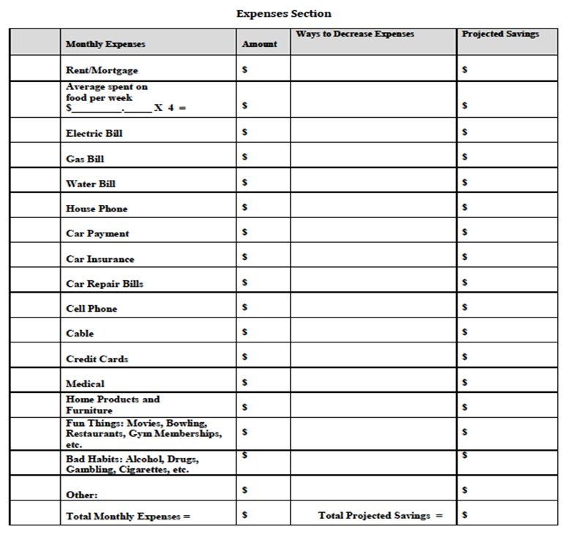
Financial Management Worksheet
See Pages 224-225
Review rationale
Record monthly expenses in “Amount”section of FMW
Record “Total Monthly Expenses” in this section
Determine “Ways to Decrease Expenses” in this section
Record “Total Projected Savings” in this section
Notes:
52

Slide 53
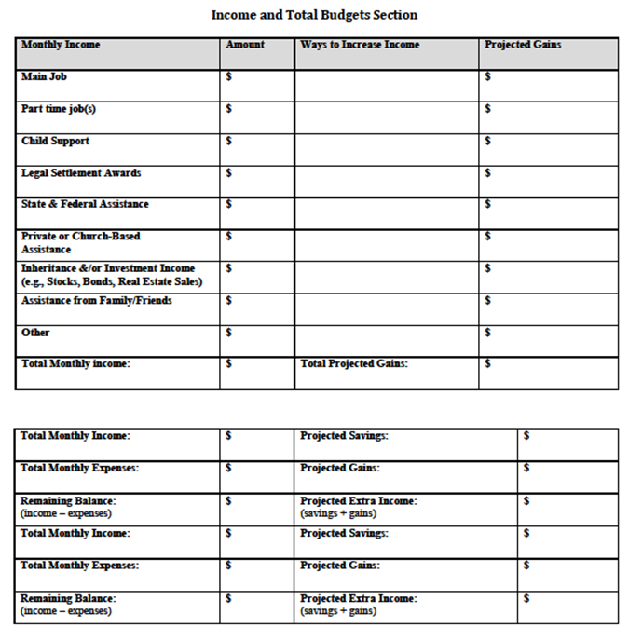
Financial Management
Record monthly income in “Amount” section of FMW
Record “Ways to Increase Income” in this section
Record “Projected Gains” in this section
Record total income, expense, savings and gain totals
Record balances in their respective sections, including their projections
See Pages 224-225
Notes:
53

Slide 55
Concluding Treatment & Planning for Success
Solicit & provide strengths of family relevant to maintaining:
great family relationships
personal achievements
treatment goals
Instruct family in exchanging what is appreciated about eachother, including provider.
Notes:
55

Slide 56
Contact Information
Brad Donohue, Ph.D.
Professor, University of Nevada Las Vegas
Department of Psychology
455030 Maryland Parkway
Box 5030
Las Vegas, NV 89154
Office: 702-895-2468
Cell: 702-557-5111
Email: bradley.donohue@gmail.com
Notes:
56
56

