Slide 1
Family Behavioral Therapy: An Evidence-Based Approach for Adolescent Substance Abuse and Associated Problems
Notes:
1

Slide 2
Workshop Agenda
Theory
Evidence
Overview
Therapeutic Style
Treatment Components
Notes:
2

Slide 3
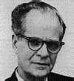
Theoretical Basis
Conceptualizes drug use as a primary reinforcer, enhanced by:
-Modeling
-Encouragement & guidance to use
-Physiological & situational prompts to use
-Insufficient reinforcement for non-drug activities
-Remoteness/uncertainty of neg. consequences of drug use
Derived from Community Reinforcement Approach (CRA)
Notes:
3

Slide 4
Evidence for CRA
Examples of Controlled CRA Alcohol Studies
Azrin, 1976; Azrin, Sisson, Meyers, & Godley, 1982; Miller & Meyers, 2001; Smith, Meyers, & Delaney, 1998; Miller, Meyers, & Tonigan, 1999; Smith, Meyers, & Delaney, 1998
Examples of Controlled CRA Drug Studies
Abbott, Wellner et al., 1998; Bickel, Amass et al., 1997; Dennis, Godley et al. 2001; Higgins, Budney, & Bickel, 1994; Higgens, Budney et al., 1995; Higgins, Budney et al., 1997; Higgins, Wong et al., 2000; Higgins, Sigmon et al., 2003
Notes:
4

Slide 5
Evidence for FBT
Controlled Drug and Alcohol Studies
Azrin, Acierno et al., 1996; Azrin, Donohue et al., 2001; Azrin, Donohue et al., 1994; Azrin, McMahon et al., 1994; Donohue, Azrin et al., 1998
Uncontrolled Drug and Alcohol Studies
Donohue, Romero et al., 2010; Donohue & Azrin, 2002; LaPota, Donohue, Warren, & Allen, 2011; Romero, Donohue, Allen, 2010; Romero, Donohue et al., 2010
Notes:
5

Slide 6
Mechanisms of Change in FBT
Treatment attempts to prevent antecedent conditions that facilitate drug use & other problem behaviors by:
Enhancing social relationships and skills needed to establish abstinence and pro-social behavior.
Teaching strategies to prevent urges and impulsive behaviors that make drug use and other problem behaviors easier.
Allowing or facilitating neg. consequences for drug use
and other problem behaviors.
Notes:
6

Slide 7
FBT Intervention Components in Adolescents
Preparatory:
Structured Agendas
Program Orientation
Motivation-Focused:
Treatment Planning
Consequence Review
Foundation Modules:
Contingency Management
Stimulus Control
Self-Control
Job Getting Skills Training
Communication Skills Training
Arousal (Emotion) Management
Positive Request
Reciprocity Awareness

Slide 8
Format of Intervention Components
Each intervention component includes:
Manual
Detailed explanation of how to implement each intervention
Initial Session Protocol
Step by step checklist used the first time an intervention is implemented
Future Session Protocol
Step by step checklist used for interventions in subsequent sessions
Worksheets
Layout the steps of the specific intervention in simplified terms
Practice Assignments
Homework assignment for client/family to practice skills outside of sessions
Notes:
8

Slide 9
Appropriate Settings for FBT
Outcome studies of FBT in adolescent samples have been conducted in outpatient mental health facilities
– so this is the preferred setting.
Some community-based agencies have been funded to implement FBT in home and inpatient mental health settings.
Notes:
9

Slide 10
Appropriate Settings for FBT
Factors to consider when implementing FBT in inpatient facilities
Significant others must be able to visit the facility
Patients must have enough time in facility to learn FBT
Must have outpatient care after discharge.
Need opportunities to practice learned skill sets during brief excursions from facility.
Outcomes have yet to be formally examined within the context of inpatient therapeutic milieus.
FBT is not appropriate for peer group, multi-family, or exclusive individual applications.
Notes:
10

Slide 11
Appropriate Targets
Drug and alcohol abuse:
Mood disorders
Family dysfunction
Incarceration/conduct disorders
Unemployment
School truancy
Child Maltreatment
Notes:
11

Slide 12
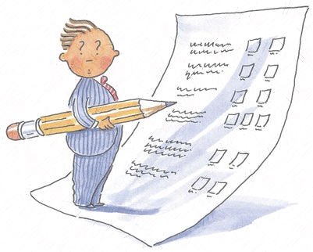
Assessment
Administer assessment measures before, during & after treatment
Person administering, interpreting, and recording assessment needs to be legally, competently, and ethically qualified
Measures must be consistent with presenting problems and agency requirements (Allen, Donohue, Sutton, Haderlie, and LaPota, 2009).
Broad-screen urinalysis testing/breathalyzers
Self-reports of substance use (e.g., Timeline Follow-back)
Measures of psychiatric symptoms & mental health diagnoses
Family Environment Scale/satisfaction measures
Risk Assessment Battery
Notes:
12

Slide 13
Number of Sessions
Up to 16 tx. sessions
Each session about 60 to 90 mins.
Tx. Usually lasts 4 to 6 months, depending on context.
Sessions fade in frequency as goals are accomplished.
Notes:
13

Slide 14
Significant Other Support
Identified client = youth
Primary sig. others = legal guardians
2ndry sig. others = other family/friends
Sig. others need to be:
sober or desire sobriety and be relatively adjusted
have an interest in youth’s well-being
Sig. others help youth:
attend therapy
complete homework assignments
provide encouragement & rewards
model skills
provide insights
Role of small children is limited (e.g., participate in review of family activities, appreciation exchanges; non-drug problem-behav. conversation)
Notes:
14

Slide 15
Order and Extent to Which Interventions Implemented
Post-Assessment
1st: Orientation session (once)
2nd: Consequence Review (and when motivation is low)
3rd: Contingency Management (& usually remaining
sessions)
4th: Treatment Planning (once)
*Remaining interventions occur based on family interest
(usually successive and cumulative).
Notes:
15

Slide 16
Prompting Checklists Guide
Providers During Sessions
Prompting checklists prompt specific steps required to implement each of the intervention components.
All intervention components:
Initial Session Prompting Checklist
Most intervention components:
Future Session Prompting Checklist
Notes:
16

Slide 17
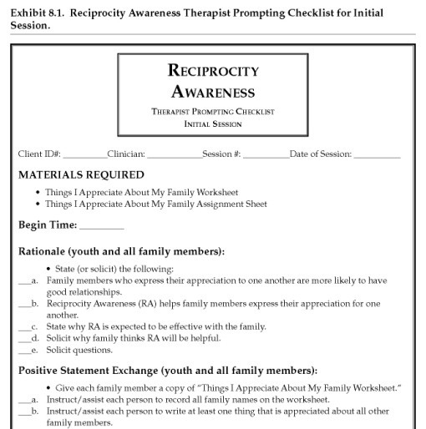
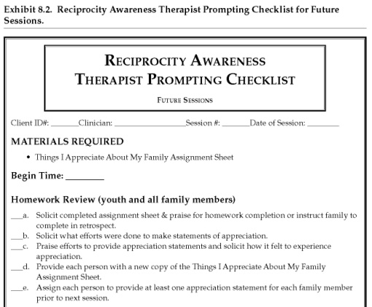
Prompting Checklists Guide
Providers During Sessions
General content of initial intervention session prompting checklists:
materials required
rationale for treatment
steps necessary to do intervention
ratings of helpfulness & youth compliance
General format of future intervention session prompting checklists:
materials required
steps necessary in reviewing assignment
steps necessary in giving new assignment
ratings of helpfulness & youth compliance
-Glance at checklist, look up, and proceed to implement.
-Free to do whatever clinically indicated between prompts.
Notes:
17

Slide 18
Treatment Integrity
What is treatment integrity?
How do you feel about treatment integrity?
Programs that utilize standardized manuals and evaluate treatment integrity are consistently rated better than those programs that do not (Moyer, Finney, & Swearingen, 2002).
Integrity = # of protocol items completed / /#possible.
Reliability = # of agreements / # agreements + disagreements X 100.
Treatment Integrity Review Form (see p. 26 in book)
Notes:
18

Slide 19
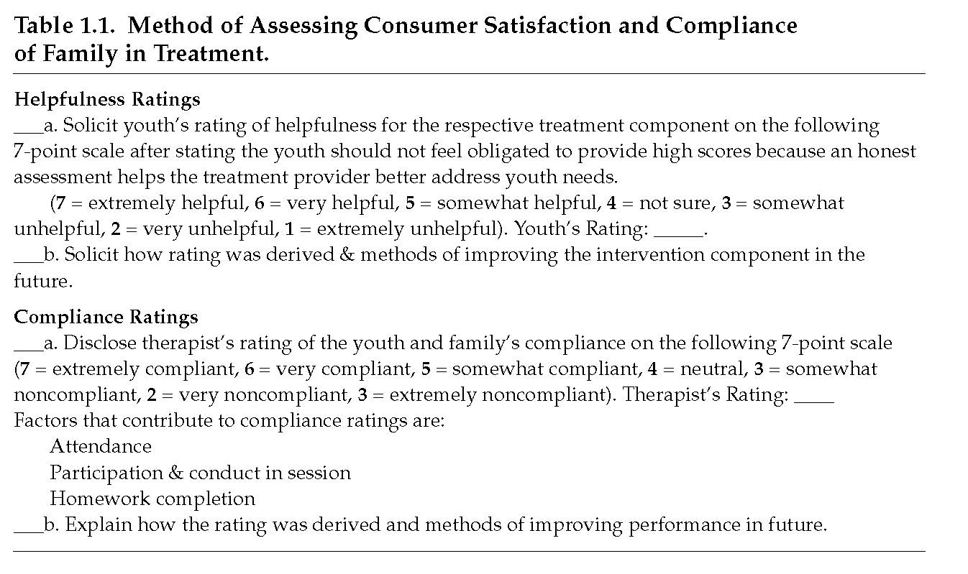
Assessing Consumer Satisfaction and Compliance of Family (see p. 27)
Notes:
19

Slide 20
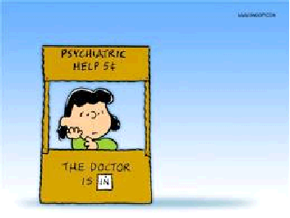
Notes:
20

Slide 21
Role-Playing
Most FBT intervention components use role-plays to teach skills.
Neg. assertion in avoiding punishment (responding to upset or criticism in others)
Pos. assertion in soliciting reinforcement (asking peer for a date or parent for car)
Refusing offers to use illicit drugs or alcohol.
Notes:
21

Slide 22
Therapy Assignments
Strategies to increase homework completion:
Role-play until clients can do skills in difficult scenarios (easy to difficult).
Role-play assignment recording process w/ family & state it will be reviewed.
Establish where recording form will be kept & when it will be reviewed.
When reviewing homework, instruct family to provide form, don’t ask for it.
Blame homework failure on external event.
Instruct family to complete missed homework assignment in retrospect based on memory or what they would have liked to have done.
Notes:
22

Slide 23
What if a Significant Other is Unavailable for Session?
Emphasize intervention components that do not require participation of significant others.
Indicate not applicable (NA) for prescribed protocol steps in prompting checklists not conducted due to absence of sig. other.
These instructional steps are not considered for treatment integrity.
Notes:
23

Slide 24
How To Manage Upset in Family During Treatment Sessions?
Establish communication guidelines early in therapy
Hear, Empathize, Alternatives, Review, Decide (HEARD)
Instruct upset family members to explain how they may have contributed to the problem.
Teach upset family members to blame problem behavior on some aspect in the environment that is beyond control.
Instruct upset family members to use Positive Request Handout to express what they desire.
Notes:
24

Slide 25
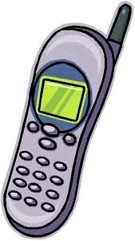
Phone Contact to Enhance Attendance and Participation
Initial engagement call (youth & parent separately)
Solicit reasons for referral and empathize.
Empathize w/ concerns.
Query goals & express importance of such desires.
Briefly express desires will be targeted in FBT.
Have repeat scheduled session time & how to get to clinic.
Tell to come 5-mins. early to beat traffic.
Review obstacles to session attendance and review solutions.
Between session calls (3 days prior to sessions; youth & parent separately)
things done well in past.
therapy assignments.
what looking forward to in next session.
Notes:
25

Slide 26
Orientation Session
Includes youth & adult significant others at start of therapy to review:
treatment structure and approach
feelings about referral
feedback relevant to assessment findings
Satisfaction Scales (Life, Parent w/ Youth, Youth w/ Parent)
0 = completely unhappy, 100 = completely happy
Assess how 100% satisfaction can occur in areas that are low.
"An Orientation Prompting Checklist is available (see p. 21)
Notes:
26

Slide 27
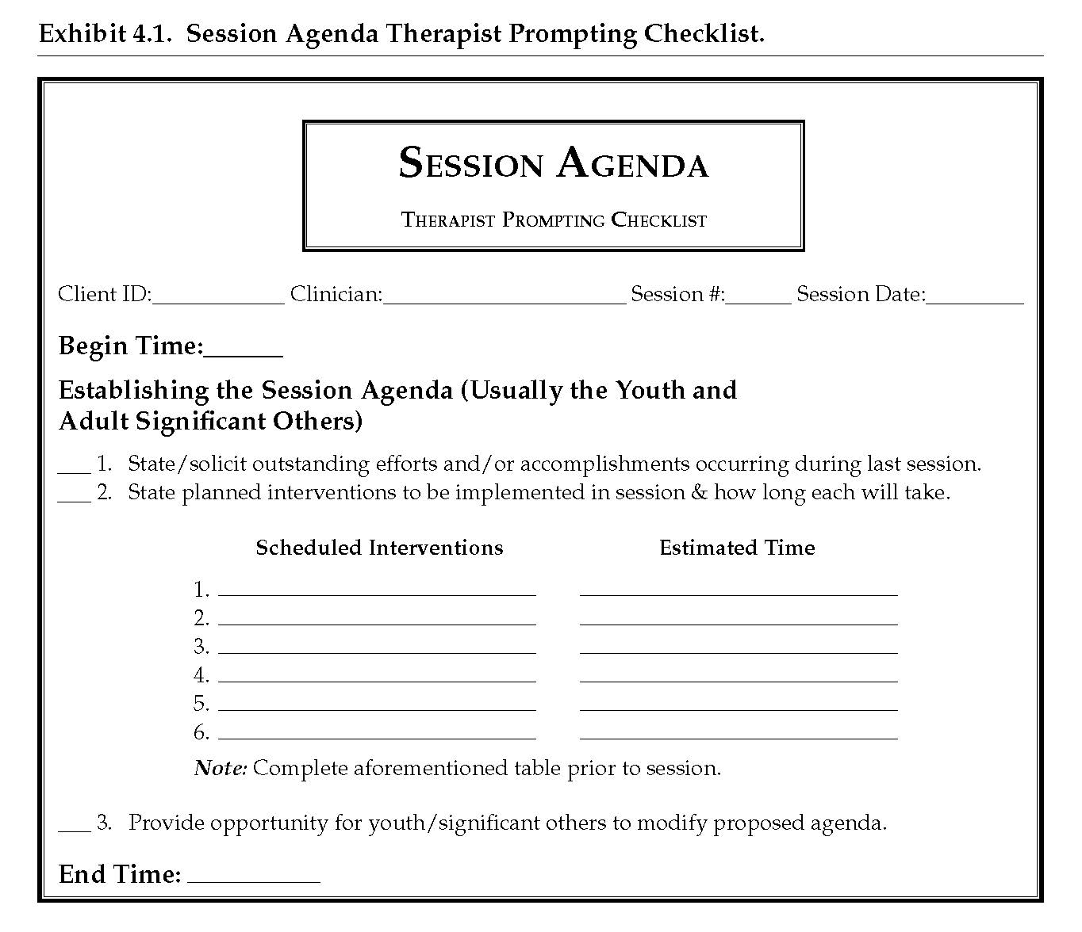
Preparing Initial Drafts for
Session Agendas
Agendas are determined by treatment plan & progress in therapy components.
Review interventions planned.
Review time needed for each intervention.
Solicit potential modifications.
Notes:
27

Slide 28
Session Agenda
Video Link: Session Agenda (1:53)
Notes:
28

Slide 29
Consequence Review Rationale
Youth are more likely to discontinue problem behaviors when their aversive consequences are perceived to be greater than their reinforcing aspects.
Getting youth to be motivated to eliminate their problem behaviors is difficult because they don’t truly appreciate the extent of their negative consequences.
Consequence Review designed to increase awareness of negative consequences of problem behavior.
Notes:
29

Slide 30
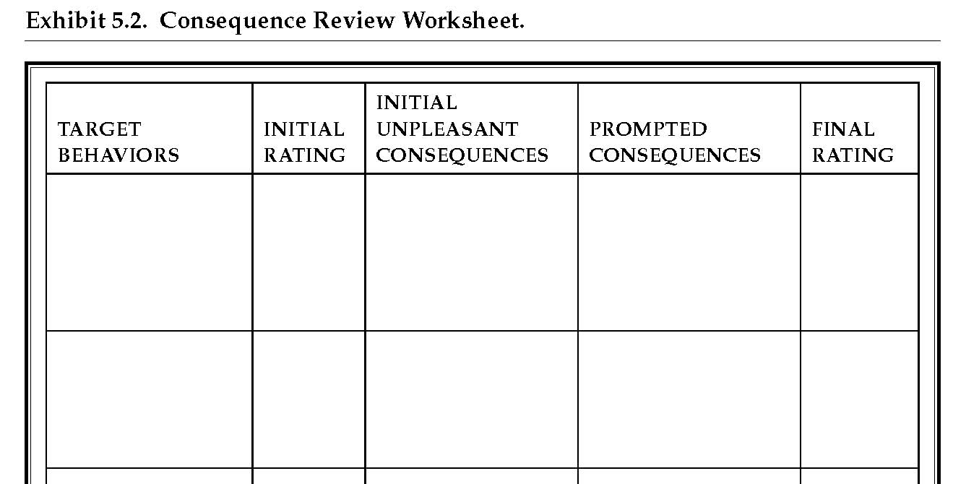
Consequence Review
Provide Rationale
Solicit at least one drug and up to several problem behaviors
Obtain initial unpleasantness ratings (0 = not at all , 100 = couldn’t get more unpleasant).
Obtain initial neg. consequences
Prompt additional neg. consequences.
List of Annoyances Worksheet may be helpful (See Exhibit. 5.3 p. 101; also in next slide)
Obtain final rating.
Review Positive consequences
Notes:
30

Slide 31
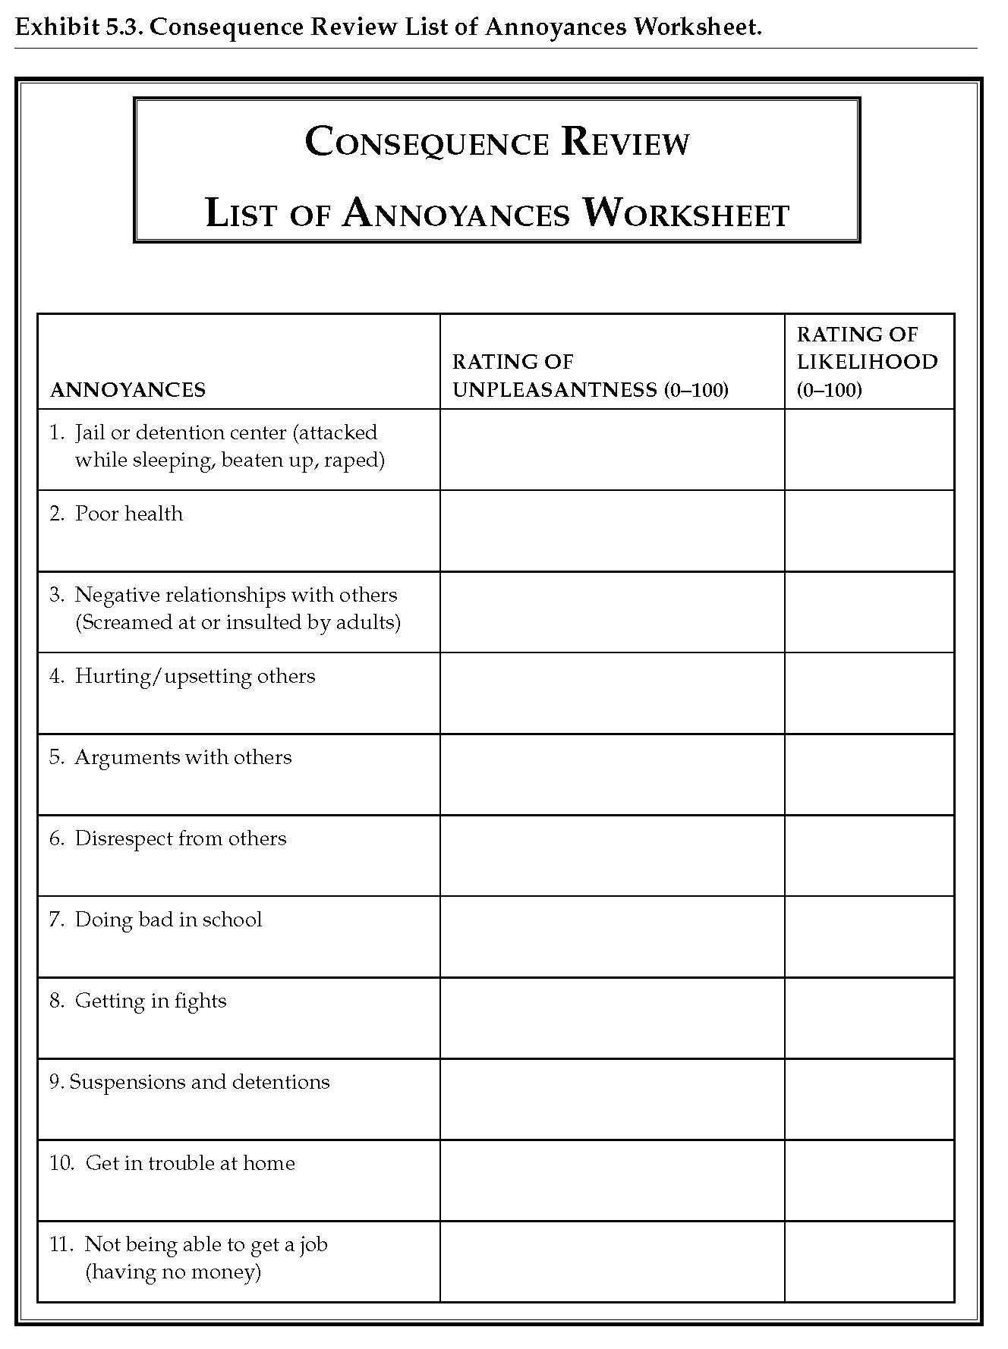
Consequence Review Continued
Obtain ratings of unpleasantness and likelihood.
Provider must use discretion in using consequences w/ high ratings in both domains as prompted consequences to review in Consequence Review Worksheet (see Exhibit 5.2)
Notes:
31

Slide 32
Consequence Review
Video Link: (15:14) Rating drugs/problem behaviors w/ youth
Notes:
32

Slide 33
Level System Rationale
A family-supported Level System (LS) is implemented to reward youth when they achieve therapeutic goals.
LS involves developing a contract in which the youth client receives desired rewards for completion of target behaviors.
Notes:
33

Slide 34
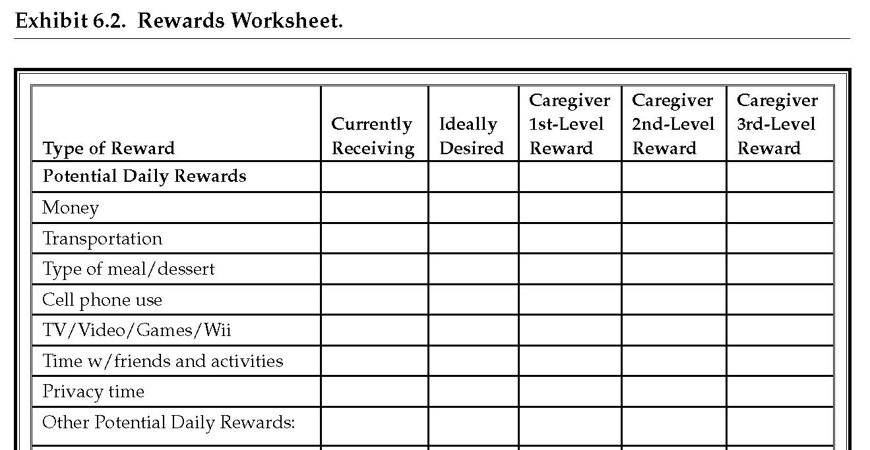
Level System
Provide Rationale
Obtain Rewards. from Youth & Verify w/ Caregiver Using Rewards Worksheet.
Notes:
34

Slide 35
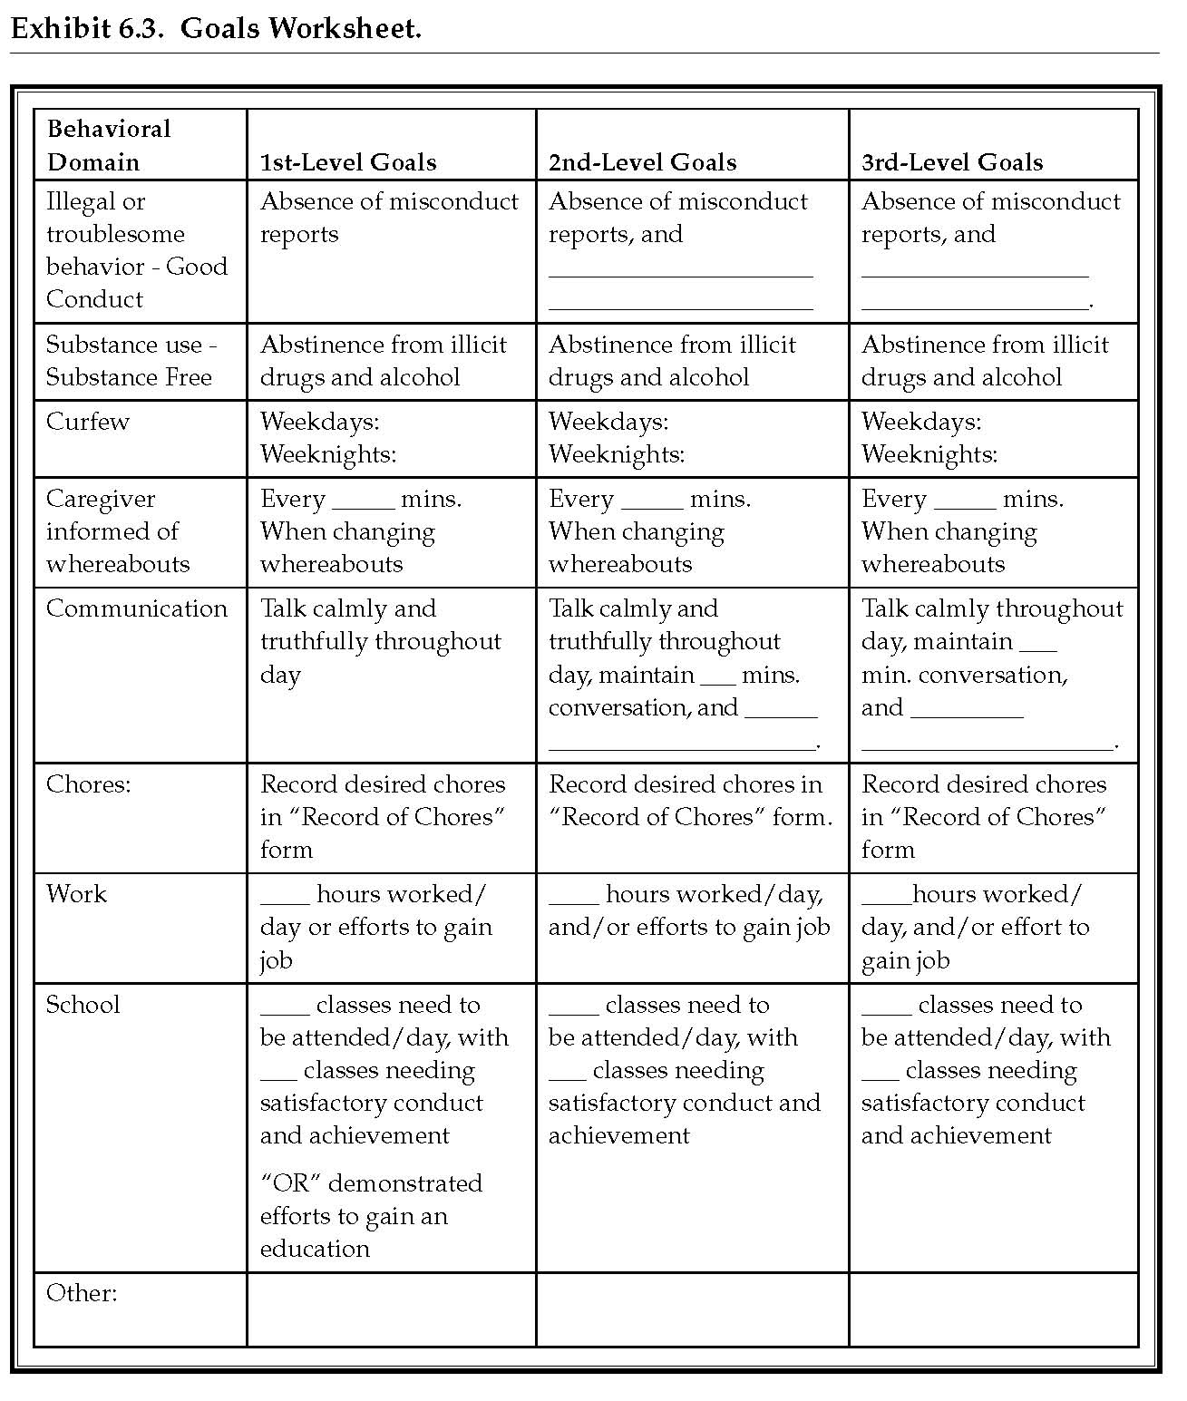
Level System
Obtain 3 levels of target behavior from sig. other using Goals Worksheet.
Note: We’ll now review forms to assist in goal development.
Notes:
35

Slide 36
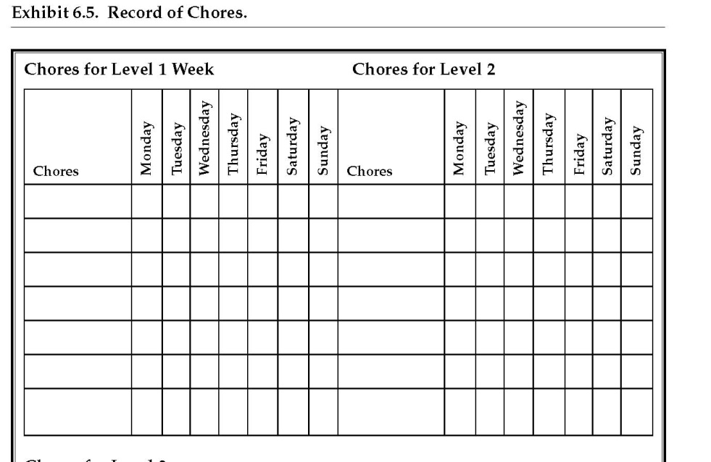
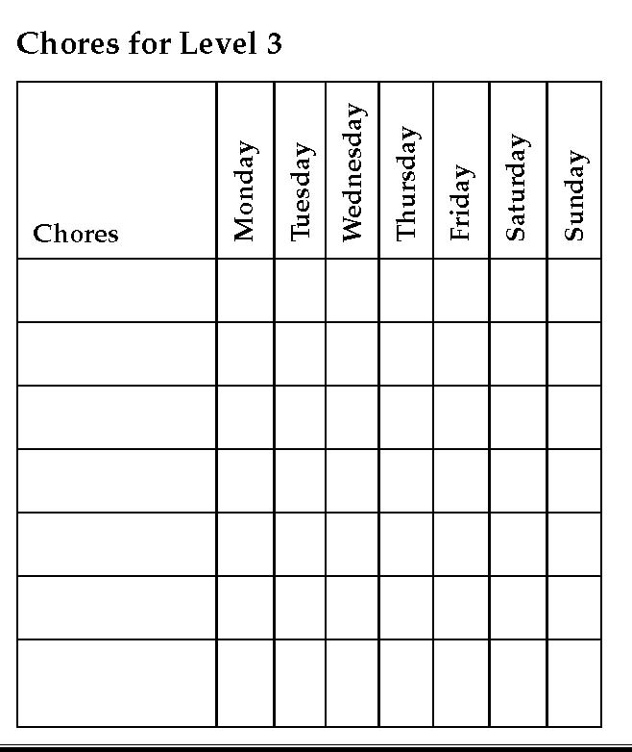
Level System
“Record of Chores” may assist in obtaining & monitoring chores for each level.
Notes:
36

Slide 37
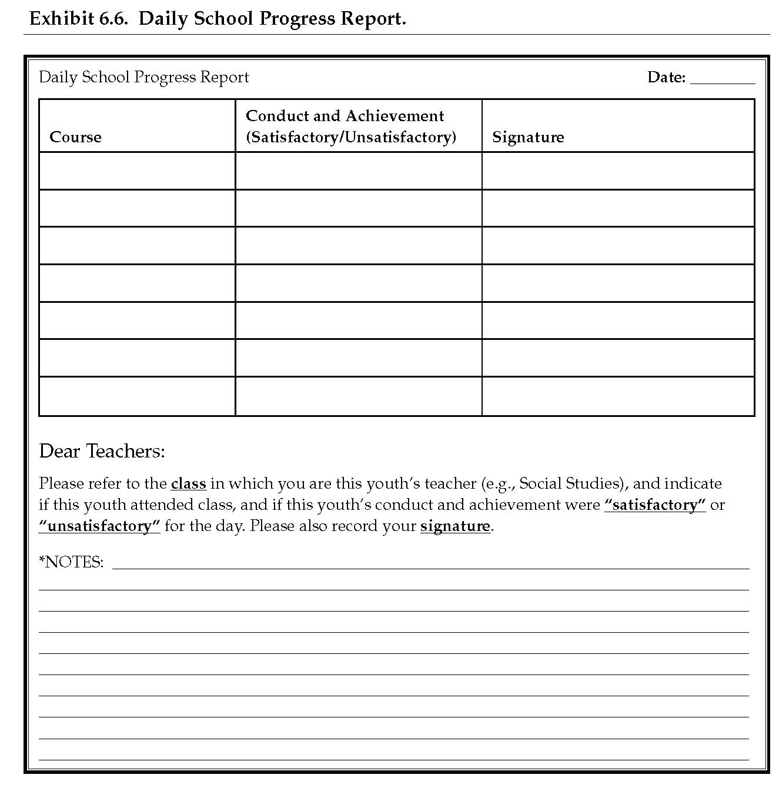
Level System
Daily School Progress Report can assist in monitoring conduct & achievement in school w/ teachers
Notes:
37

Slide 38
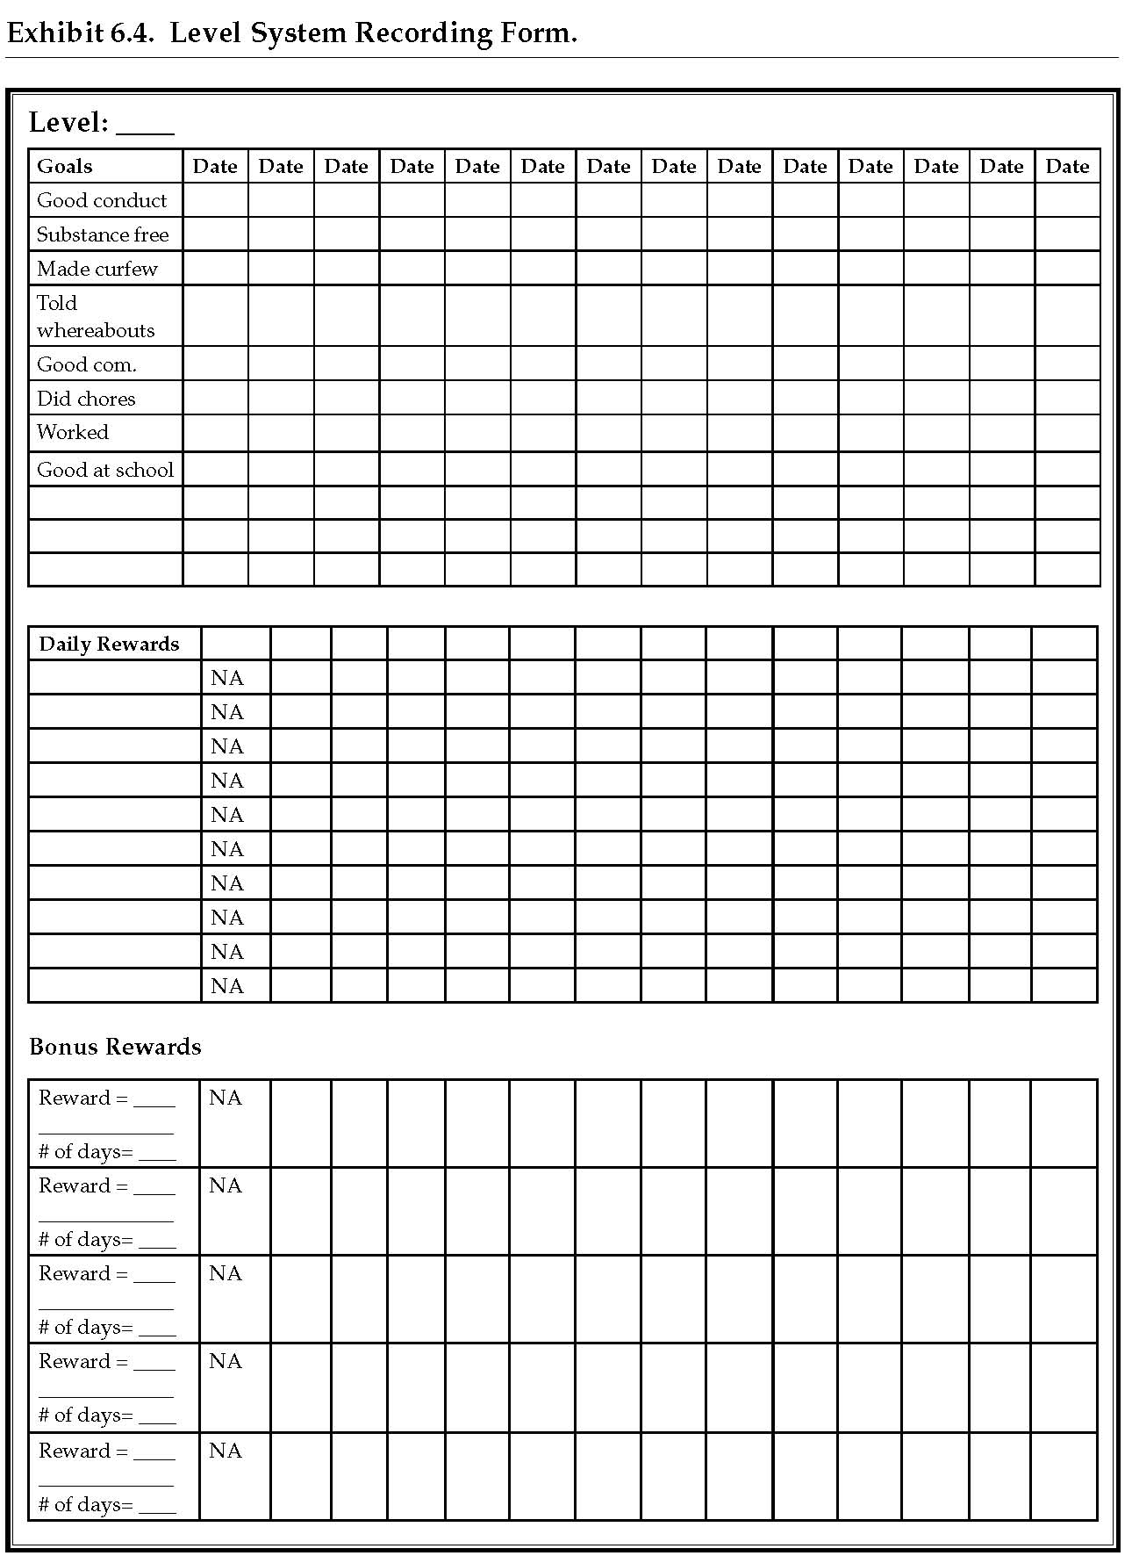
Level System
Level System Recording Form assists in managing contingencies.
Goals should ideally be made more specific in this form to reduce misunderstandings.
Notes:
38

Slide 39
Level System
Video Link: Part 1 (5:55) Rationale
Part 2 (11:21) Solicit Rewards w/ youth
Part 3 (3:24) Rev. Bonus Rewards w/sig other.
Part 4 (25:19) Rev. goals w/youth & Sig other.
Part 5 (8:04) Rev. Goal achievement (future session)
Notes:
39

Slide 40
Treatment Planning Rationale
Treatment Planning is determined by youth & caregivers.
Youth and caregivers determine the extent to which 5 skill-based treatments will be emphasized in therapy.
Notes:
40

Slide 41
Treatment Planning
Read intervention summaries in the Intervention Summary Worksheet, & solicit how each would be helpful (Exhibit 7.2; see this slide)
Agree or empathize with responses.
Notes:
41

Slide 42
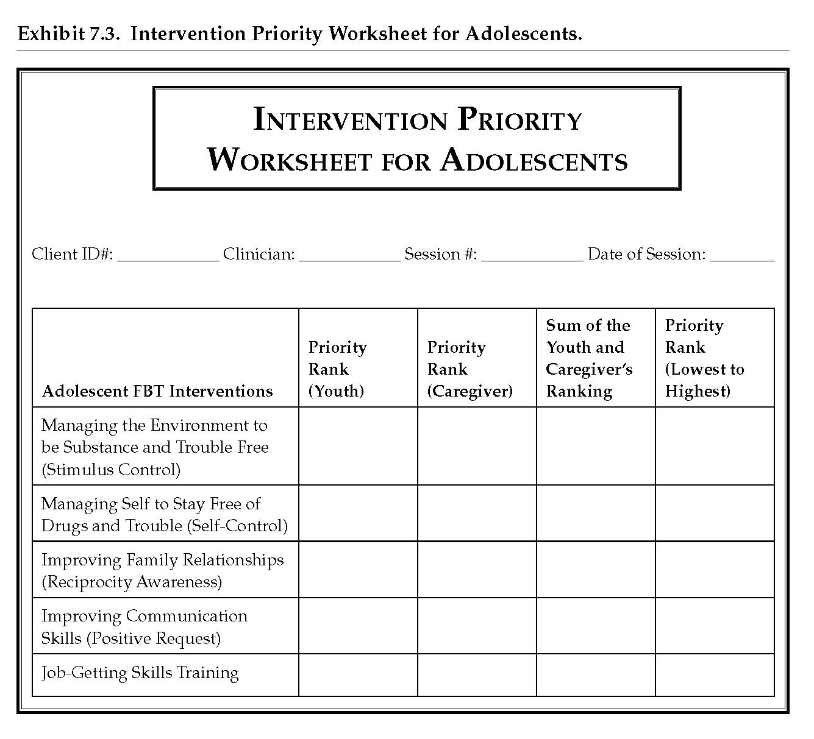
Treatment Planning
Solicit youth & caregiver rankings of interventions using Intervention Priority Worksheet for Adolescents.
Sum youth & caregiver intervention rankings.
Rank summative rankings from lowest to highest priority.
Interventions will be administered in the order to which they are prioritized (highest to lowest), which emphasizes them in therapy.
Notes:
42

Slide 43
Reciprocity Awareness Rationale
Healthy relationships are marked by an equitable exchange of reinforcement.
In Reciprocity Awareness family members express appreciation for one another.
Implemented early in FBT, & when tension is present in family.
Notes:
43

Slide 44
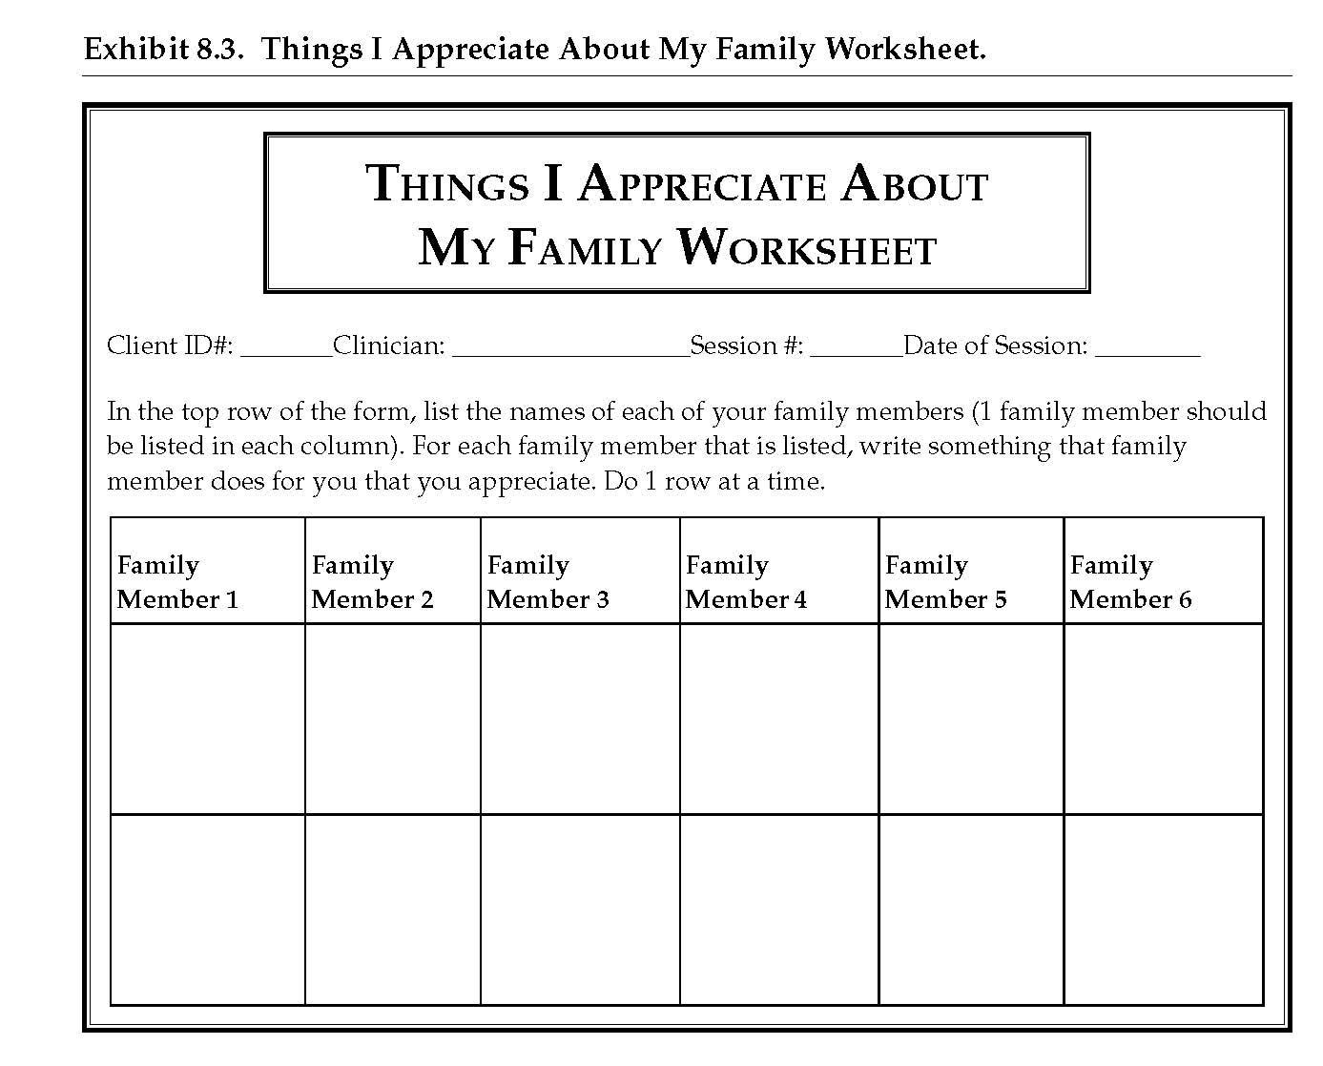
Reciprocity Awareness
Provide rationale
Instruct members to record things that are appreciated about one another.
Exchange appreciations.
Encourage recipient to indicate these things will continue.
Notes:
44

Slide 45
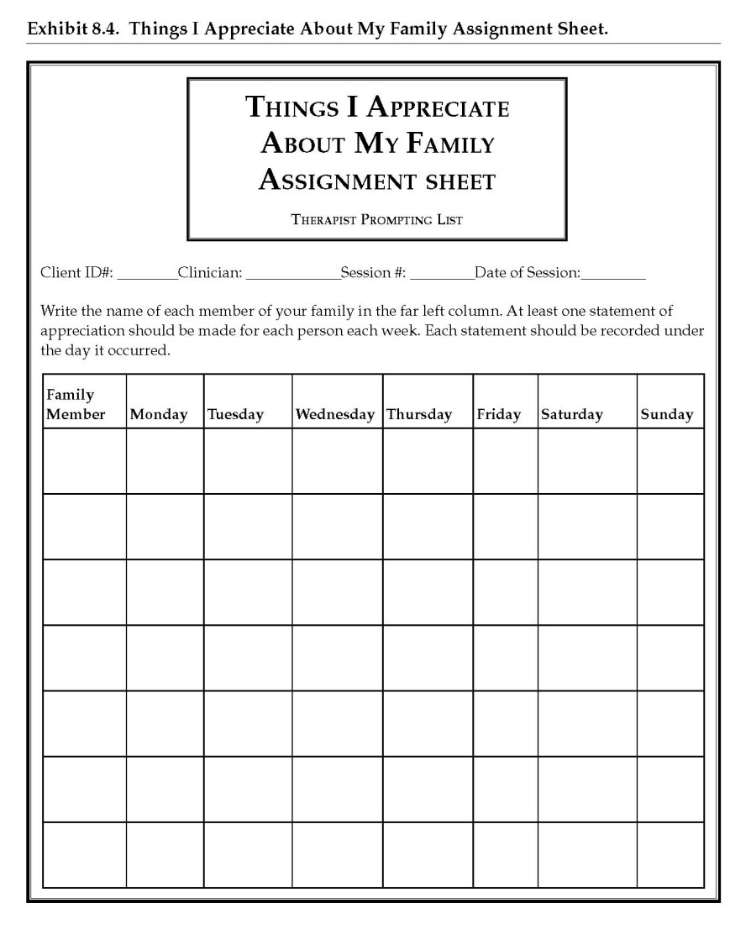
Reciprocity Awareness
Provide form to assign homework.
Assist family in recording family members.
Assign 1 appreciation for each family member each day.
Get commitment from each member to complete assignment.
Remind family each positive statement should be reciprocated!
Notes:
45

Slide 46
Positive Request
Poorly stated requests result in less reinforcement, leading to upset/dissatisfaction.
Negative emotional states lead to undesired behaviors.
Stealing to obtain reinforcement that is difficult otherwise.
Arguments to intensify importance of what is desired.
Drug use to eliminate negative emotional states.
Positive Request is designed to improve positive communication.
Notes:
46

Slide 47
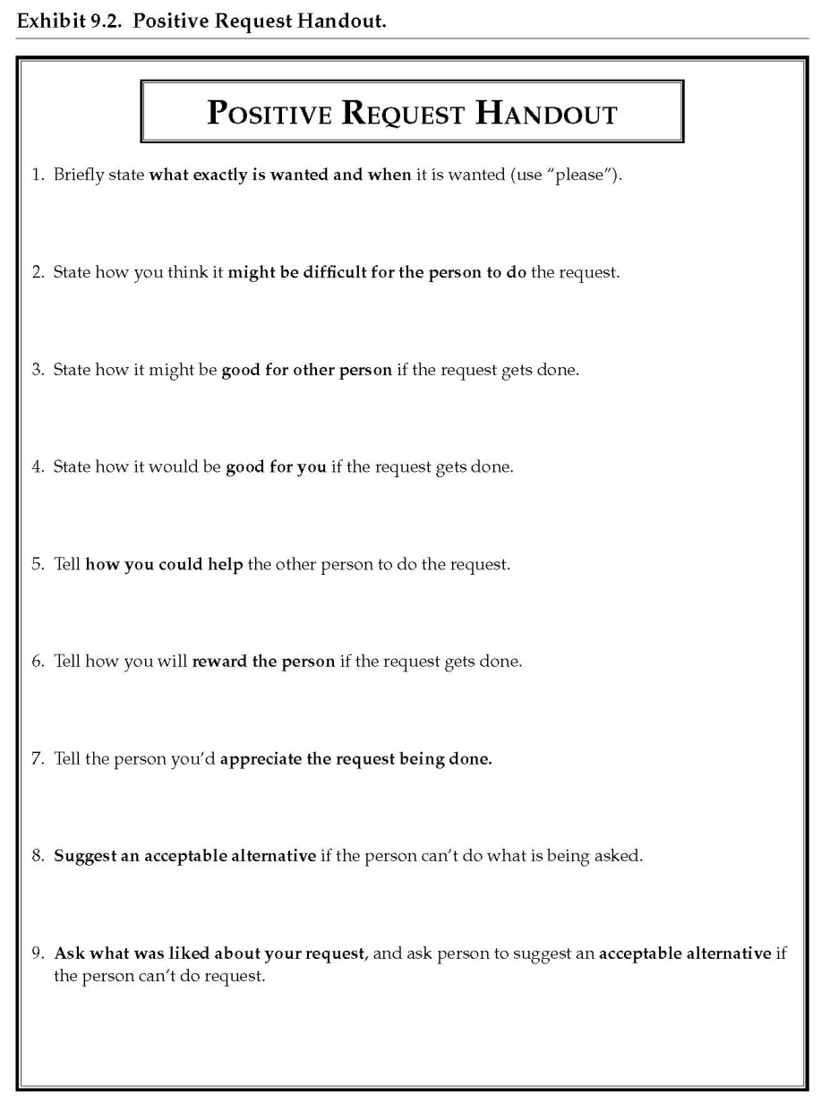
Positive Request: Worksheet
Distribute PR Handout.
Indicate all listed steps will be attempted for practice, but all are not necessary in real-life situations.
Solicit example of something desired by 1 member.
Role-play PR w/ family.
Notes:
47

Slide 48
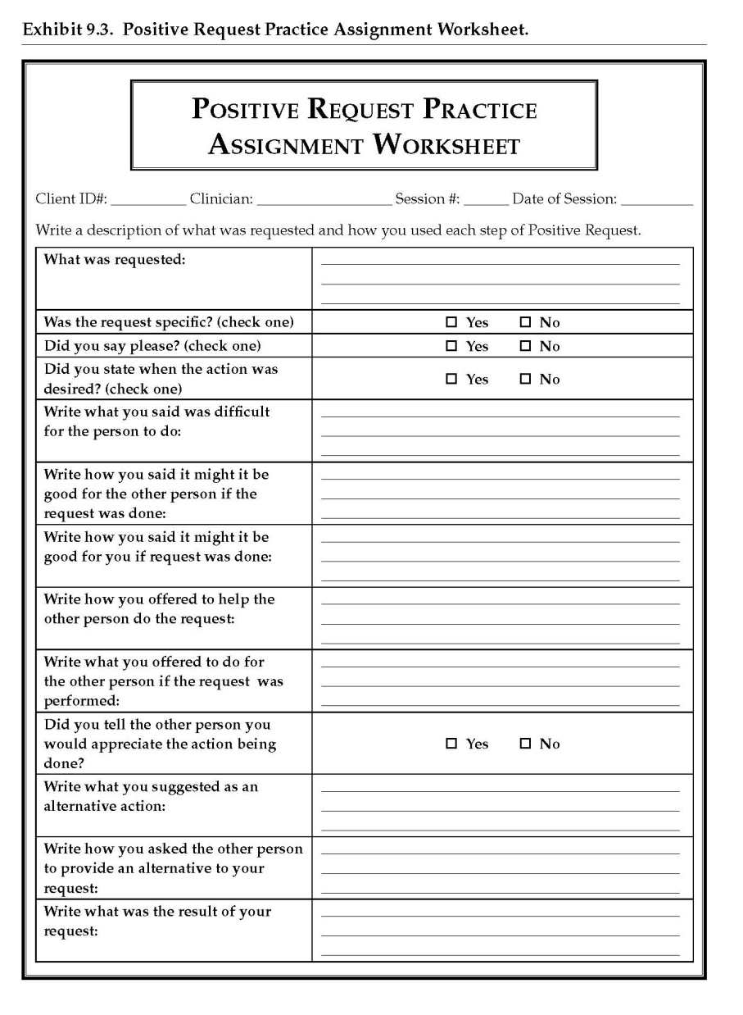
Positive Request: Worksheet
Assign homework for review in future session.
Notes:
48

Slide 49
Positive Request Assignment
Video Link: Part 1 (11:42) Impromptu
Part 2 (7:36) Rationale/ TP models PR
Part 3 (5:27) Role-Play PR w/youth
Notes:
49

Slide 50
Environmental/Stimulus Control
Triggers in the environment lead to drug use and problem behaviors.
In this intervention, youth and sig. others are taught to identify “at-risk” and “safe” triggers for youth.
The team then works to restructure the environment to minimize time with “at-risk” items.

Slide 51
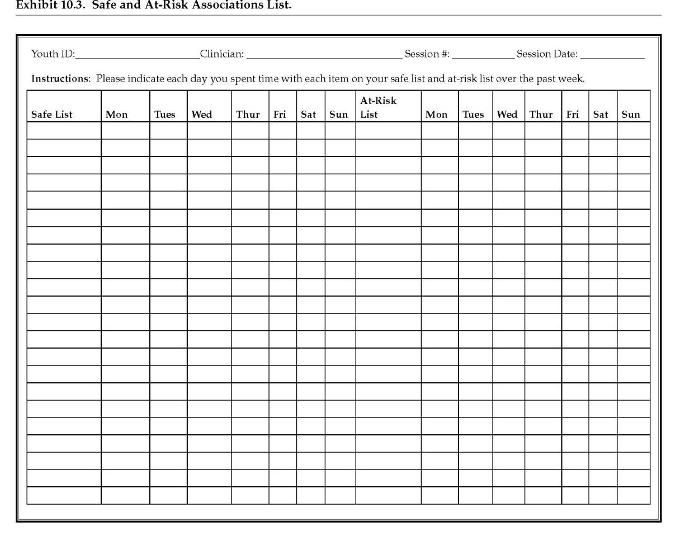
Developing “Safe/At-Risk” lists
Obtain w/ youth & sig other individually to generate a comprehensive list of “safe” and “at-risk” items to drug use/problem behavior.
Notes:
51

Slide 52
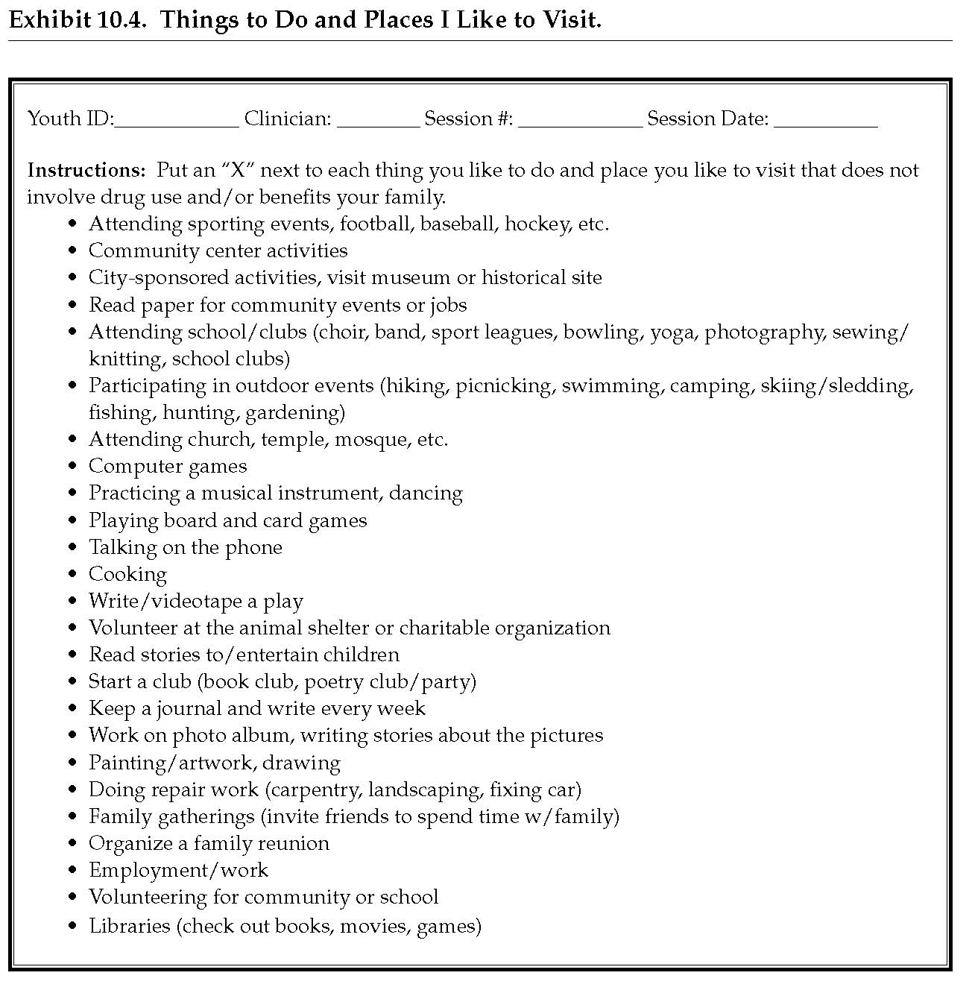
Environmental/Stimulus Control
Use the “Things to Do and Places I Like to Visit Worksheet” to generate additional “Safe” items.
Notes:
52

Slide 53
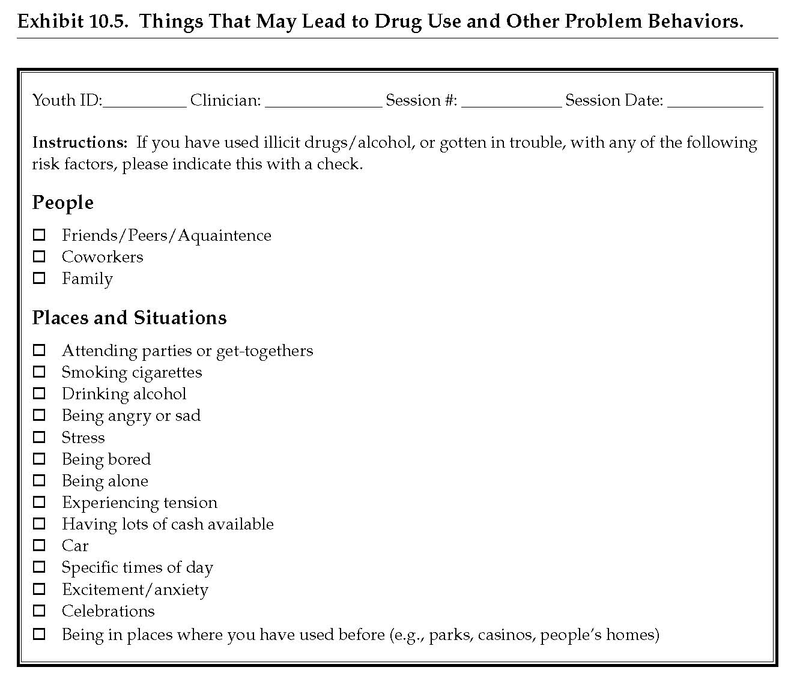
Environmental/Stimulus Control
Use “Things That May Lead to Drug Use and Other Problem Behaviors” Worksheet to generate additional “At-risk” items.
Notes:
53

Slide 54
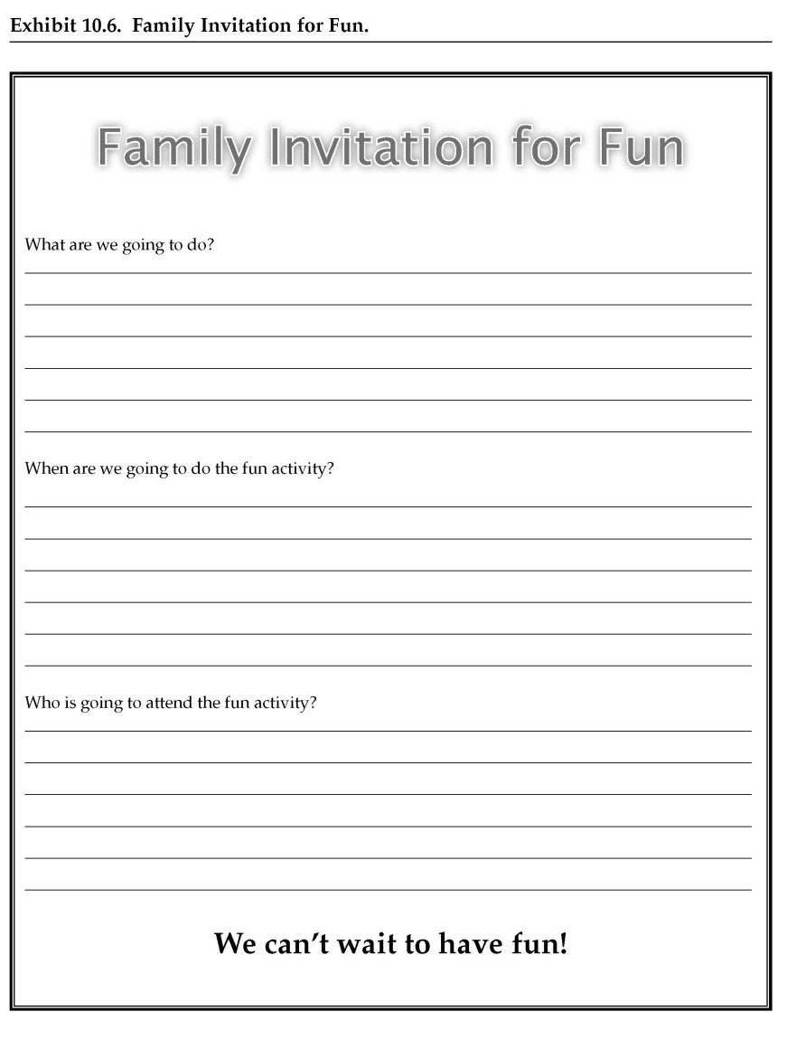
Environmental/Stimulus Control
Solicit family activity from youth.
Notes:
54

Slide 55
Environmental/Stimulus Control
Future sessions involve:
Reviewing assigned family activity, & assign another activity.
Meeting w/ youth & caregiver to review Safe Items.
Meeting w/ youth & caregivers individually to review At-Risk items.
Solicit things youth did (or can do) to stay clean & out of trouble.
Solicit things caregiver did (or can do) to assist youth in staying clean & out of trouble.

Slide 56
Environmental/Stimulus Control
Video Link : Part 1 (2:18) Rev. likes/dislikes of Triggers w/youth
Part 2 (0:25) Solicit Confidentiality w/Youth
Part 3 (18:37) Rev. time spent w/ items on “safe”/ “at-risk” lists (future session)
Notes:
56

Slide 57
Self Control
Drug use & troublesome behavior are associated with w/ impulse control problems.
Self Control designed to teach youth to identify antecedents to problem behavior, & replace w/ non-problem behavior.
Notes:
57

Slide 58
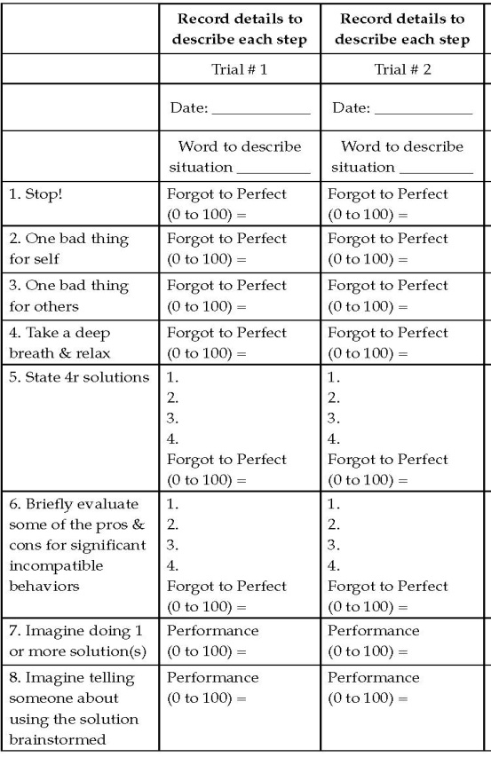
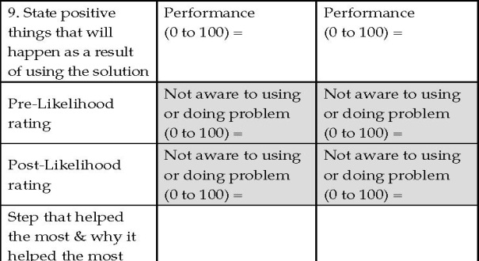
Self Control
Solicit trigger situation.
Role-play self control
trials.
Notes:
58

Slide 59
Self Control
Video Link: Part 1 (10:50) Brainstorm triggers with youth/TP Models SC/Client rates TP
Part 2 (8:04) Role-Play SC w/youth
Part 3 (9:46) Youth/TP rate youth’s role-play of skills
Notes:
59

Slide 60
Job-Getting Skills Training
Employment is usually incompatible with drug use/problem behavior because it raises self-worth and provides learning opportunities.
Job-Getting Skills Training may be used to assist youth in getting job interviews, and doing well in these interviews.
Notes:
60

Slide 61
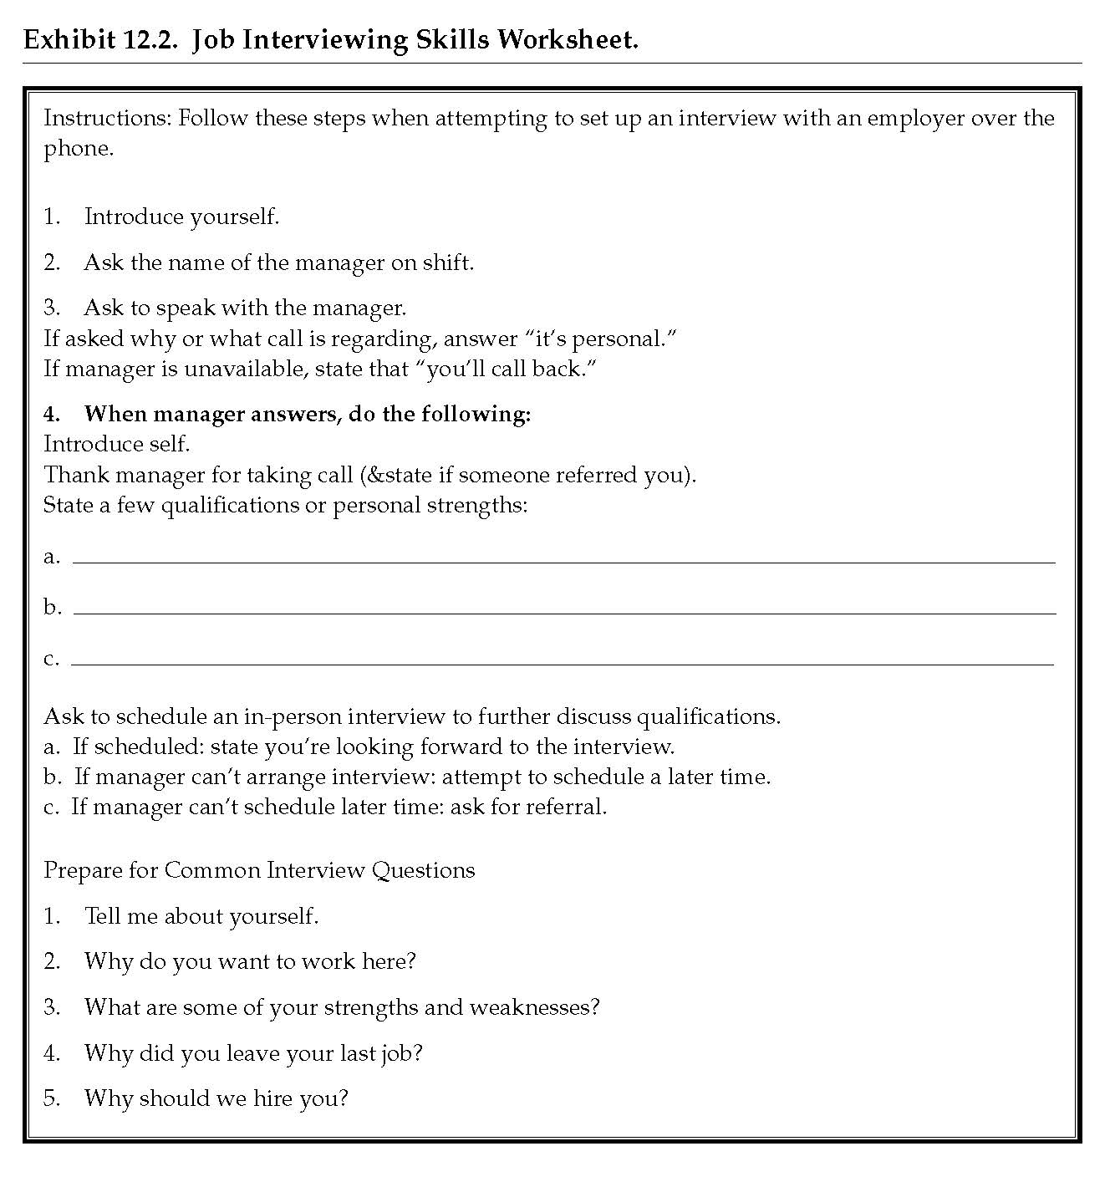
Gaining Employment
Review how a job would assist youth.
Determine 3 strengths of youth relevant to gaining employment.
Determine potential employers.
Use Job Interviewing Skills Worksheet (see Exhibit 12.2) to role-play job-interview solicitation (usually via phone call).
Role-play preparation of job interview using Job Interviewing Skills Worksheet.
Assist youth in making phone calls to potential employers.
Notes:
61

Slide 62
Gaining Employment
Video Link: Part 1 (2:33) TP Explains steps for soliciting interview.
Part 2 (4:54) TP models Interviewing Skills.
Part 3 (3:33) Youth Practices Soliciting interview from potential employer.
Notes:
62

Slide 63
Contact Information
Brad Donohue, Ph.D
Professor, University of Nevada Las Vegas
Department of Psychology
455030 Maryland Parkway
Box 5030
Las Vegas, NV 89154
Office: 702 895 2468
Cell: 702 557 5111
Email: bradley.donohue@unlv.com
Notes:
63
63

